Slide 1
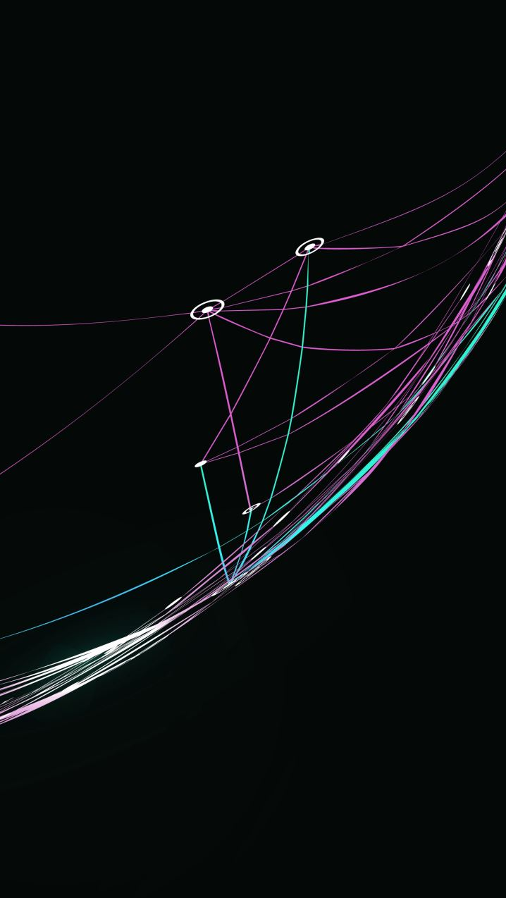
Organisational Strategy and Strategic Planning
FPA-SKPA Programme
GMME –SP 5
Lasantha Wickremesooriya
Consultant Strategist

Slide 2
The Decision Flow for Strategic Planning
Stakeholder analysis
Identifying Strategic Issues
Mandate
Aspirations
Environmental Analysis
Strategic Initiatives
Structure
Plan
of
Actions
Monitoring
&
Evaluation
Resources &
Capability Analysis
Feedback loop

Slide 3

Next Step
External Environment
Resources & Capabilities
Stakeholder Analysis
What are the important trends?
What is the impact/implications of these trends to our organisation?
What specialised resources & capabilities do we presently possess?
Given the emerging trends, what specialised resources & capabilities do we require?
Stakeholder engagement strategies

Slide 4
Summarise what the analysis reveals
What are the opportunities?
What are the challenges?
How does it affect achieving our mission?
What are the major initiatives we need to take?

Slide 5
Strengths ?
Opportunities ?
Challenges ?

Slide 6
Strategic Issues

Slide 7
What is your Institution's vision for success?
State Explicitly

Slide 8
Strategic Issues
What specific issues do we have to address (those arising from our analysis) in the next 3 years?
    Mandate?
    Environment ?
    Resources & Capabilities ?
    Stakeholders ?

Slide 9
Strategic Issues contd...
What do we wish to achieve in the next 3 years based on our mandate?
What gaps do we wish to bridge – between what we are now and what we wish to achieve?
    Reach ?
    Operations/Performance?
    Growth ?

