Slide 1
Monitoring & Evaluation
FPA-SKPA Programme
GMME
Lasantha Wickremesooriya
Consultant Strategist

Slide 3
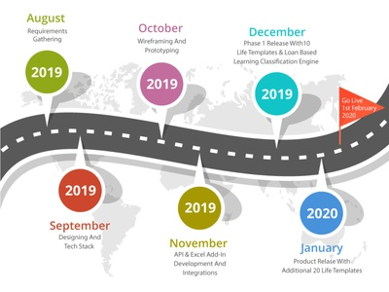
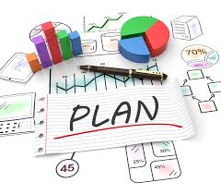
Purpose
Goal

Slide 4
Purpose
Monitoring
Goal
Evaluation

Slide 5
Monitoring & Evaluation
Monitoring
Evaluation
Continuous process of:
collecting and analysing information about a programme
comparing actual against planned results
A process that systematically and objectively assesses all the elements of a programme (e.g. design, implementation and results achieved) to determine its overall worth or significance

Slide 6
Evaluation
Performance evaluations
Quality of the service/project delivery
Results/Outcomes achieved by the project/programme
Impact evaluations
Changes in outcomes attributed to the programme executed (what would have happened to the beneficiaries if this project was not executed?)

Slide 7
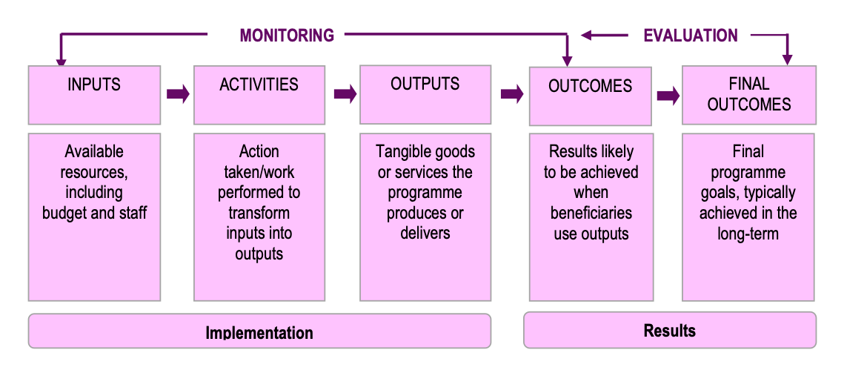
Continuous
Specific Moment of Time

Slide 9
Important considerations
Timely collection of information
Information sources: Administrative data, Reporting systems, Field surveys
Monitoring frequency (depends on the nature of the project and duration)
Compilation of reports objectively
Avoid information overload!

Slide 10
What is the purpose….?
Improve program implementation
Data on program progress and implementation
Improve program management and decision making
Inform future programming
Inform stakeholders
Accountability (donors, beneficiaries)
Advocacy

Slide 11
Discussion

