Slide 1
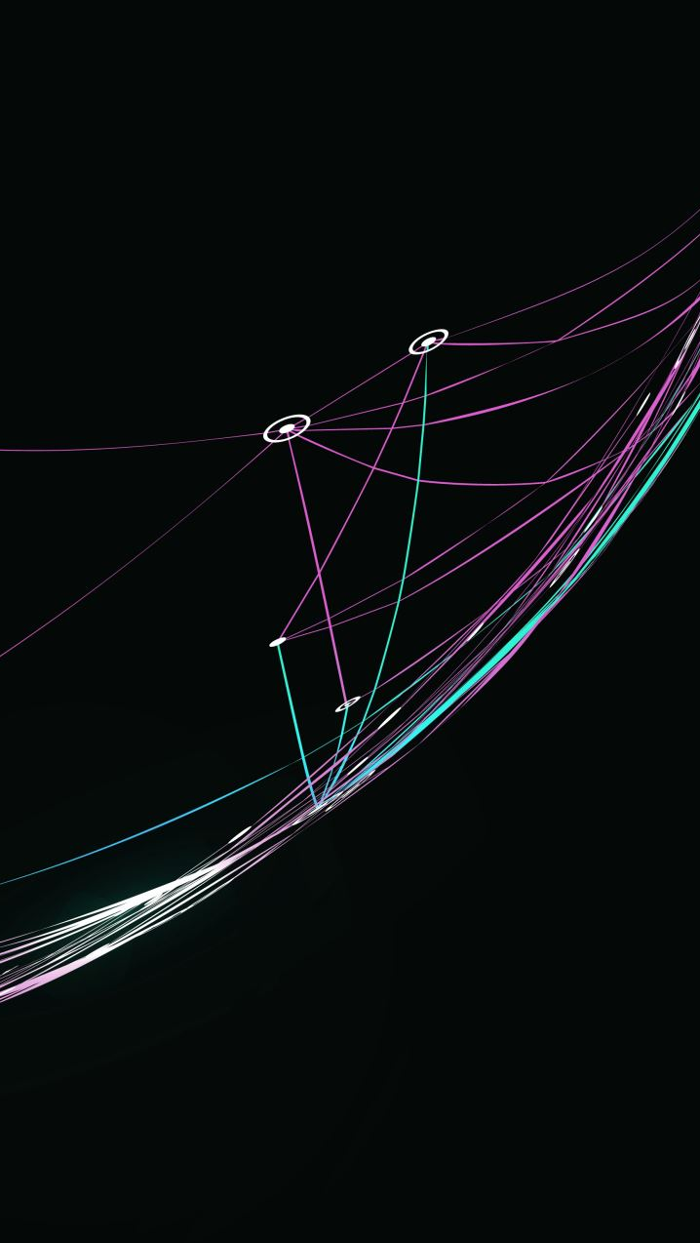
Organisational Strategy and Strategic Planning
FPA-SKPA Programme
GMME –SP 9
Lasantha Wickremesooriya
Consultant Strategist

Slide 2
The Decision Flow for Strategic Planning
Stakeholder analysis
Identifying Strategic Issues
Mandate
Aspirations
Environmental Analysis
Strategic Initiatives
Structure
Plan
of
Actions
Monitoring
&
Evaluation
Resources &
Capability Analysis
Feedback loop

Slide 3
Strategy Execution

Slide 4
Strategy execution is about translating an organization's strategic initiatives into action

Slide 5
Environment
Resources & Capabilities
Stakeholders
Vision
Mission
Strategic Issues
Goals & Strategic Initiatives
Objectives
Action points to achieve objectives
Who, what, where, when, what cost?

Slide 6
EXECUTING STRATEGY
Strategy Execution:
    is operations-driven, involving management of both people and business processes.
    Is a job for the whole management team, not just a few senior managers.
    Requires a determined commitment to change, action, and performance.

Slide 7

Good strategy execution requires a team effort. All managers have strategy-executing responsibility in their areas of authority, and all employees are active participants in the strategy execution process.

Slide 8
BUILDING AN ORGANIZATION CAPABLE
OF GOOD STRATEGY EXECUTION:
THREE KEY ACTIONS
Staffing: Assemble a strong management team and a cadre of competent employees.
01
Developing: Renew, upgrade, and revise resources and capabilities to match chosen strategy.
02
Structuring: Create strategy-supportive organization capable of good strategy execution.
03

Slide 9
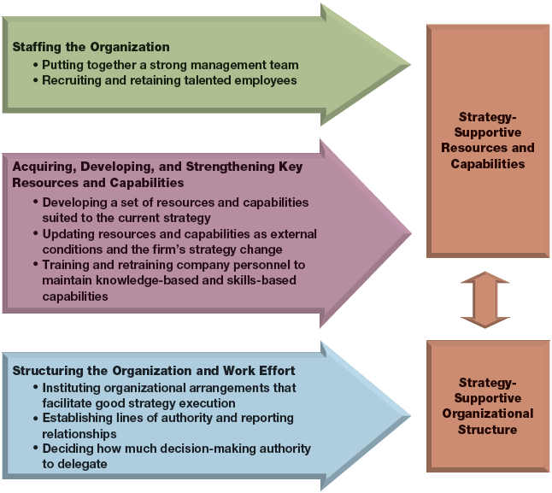
Building an Organization Capable of Proficient Strategy Execution: Three Types of Paramount Actions

Slide 10



DEVELOPING AND BUILDING CRITICAL RESOURCES AND CAPABILITIES
Approaches to Build Building
and Strengthening Capabilities
Develop
capabilities
internally
Acquire capabilities through mergers
and acquisitions
Access capabilities via collaborative partnerships

Slide 11
STRATEGY EXECUTION CAPABILITIES
Superior Strategy Execution Capabilities:
    Are difficult to imitate and socially complex process that take a long time to develop.
    Maximize organizational resources and capabilities in support of the operations.
    Lower costs and permit firms to deliver more value to prospects.
    Enable a firm to react more quickly to environmental changes

Slide 12
Action Plans
Strategic Theme
Strategic Issue
Strategic Initiative
Objectives
Action Plan
What? (Activity)
When?
(Timing)
Where? (Location)
Who?
(Person responsible)
What Cost? (Budget)

Slide 13
Monitoring & Evaluation

Slide 14
Monitoring versus Evaluation
Monitoring
Data collected on program activities
Ongoing, routine
Focus on activities and output, compared to target
Are we doing the work we planned?
Evaluation
Data collected to answer specific questions
Periodic
Focus on outcome, impact
How effective were our activities?
Notes:
THIS SLIDE IS ANIMATED
Let’s begin by comparing monitoring and evaluation.
CLICK to display Monitoring.
Monitoring is the routine collection and analysis of program data, specifically on program activities. Data collection is ongoing (weekly, monthly, quarterly, semiannually, etc.).
CLICK to display question.
Monitoring compares results to the original targets to answer the question: Are we doing the work we planned? It can alert us to problems early because we continually review program data.
CLICK to display Evaluation.
Evaluation answers specific questions about our performance. It is in-depth analysis that tells us if we should continue or improve our activities.
CLICK to display question.
Evaluation is less frequent and answers the question: How effective were our activities? Sometimes monitoring leads us to an evaluation. We may see a trend in the routine data that we cannot explain. So we could design an evaluation to help us understand what is going on.

Slide 15
Monitoring or Evaluation?
Local researchers conduct a study to determine if there are more people with possible TB symptoms coming to DOTS clinics as a result of a media campaign to promote TB screening.
A district manager reports on how many nurses were trained on interpersonal communication skills for her quarterly donor report.

Slide 16
What is the purpose?
Improve
Improve program implementation
Data on program progress and implementation
Improve program management and decision making
Inform
Inform future programming
Inform
Inform stakeholders
Accountability (donors, beneficiaries)
Advocacy

Slide 17
Who needs, uses M&E Information?
Purpose | User
To Improve program implementation | Board, Managers
To Inform and improve future programs | Donors Governments Technocrats
Inform stakeholders | Communities Beneficiaries

Slide 18
Who conducts M&E….?
Program implementer
Stakeholders
Beneficiary
Participatory process

Slide 19
How to carry out M&E?
Key Features
Program
Program Framework: Analyze and systematically lay out program elements
Identify
Identify key elements to monitor and evaluate.
Determine and describe
Determine and describe the measures to be used for monitoring and evaluation
Develop
Develop M&E Framework and action plans, including data collection and analysis, reporting and dissemination of findings.

Slide 20
What is a GOAL?
The ultimate result of efforts at a broad, population level.
Achieved over the long term (years) and through combined efforts of multiple programs (not only your CSO/CBO).
Decrease morbidity and mortality due to TB in Country X.
Reduce prevalence of TB by 50%.
Eliminate stigma of TB in our communities.

Slide 21
What is an OBJECTIVE?
Activities
Objectives
Goal
How the results of your short-term program activities contribute to the big goal.
Several objectives can relate to the same goal.

Slide 22
Objective (examples)
Aggressively advocate to increase national HIV budget by 8% each year for the next four years.
Double the percentage of secondary school students who can correctly identify TB symptoms by 2015.
Design and pilot a treatment support program for newly released drug offenders with HIV by 2025.

Slide 23
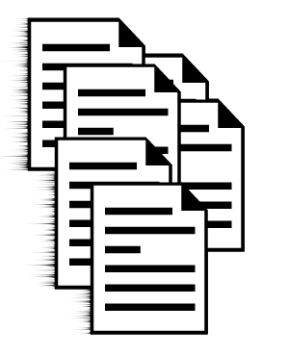
INPUTS
Resources needed to plan and implement programme
“Raw materials” of a social project
Examples
Money
Staff
Volunteers
Policies, guidelines
Equipment
Partners

Slide 24
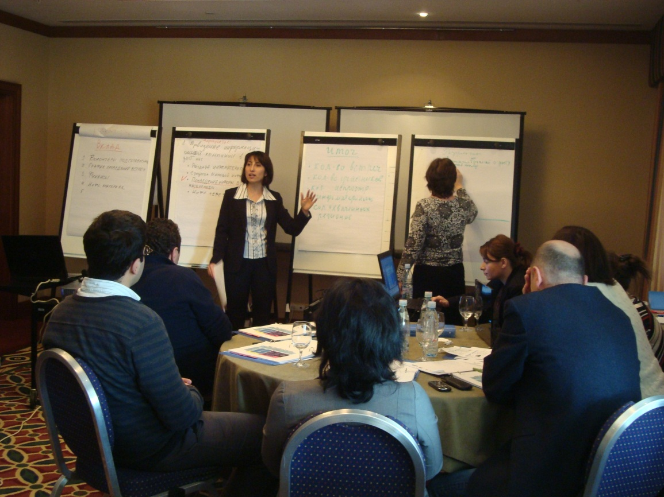
ACTIVITIES
The work that we do, what we implement
Also called “processes”
Examples
Training events
Meetings
Events
Outreach
Home visits

Slide 25

OUTPUTS
Immediate results of activities
What we can measure/count right after the activity
Examples
Number of people rehabilitated
Number of brochures produced
Number of policymakers reached with
advocacy activity

Slide 26
OUTCOMES
“Ripple effects” of CSO activities
What changes after outputs are produced
Examples
Increased funding for HIV after lobbying meeting
Short: Improved attitudes toward HIV patients among nurses after a training
  Medium: Increased satisfaction of HIV clients
  Long: HIV clients stay in treatment longer and remain connected

Slide 27
INDICATORS
How we define our activities, outputs, or outcomes
Signs or evidence we watch for to see if we have reached them
ACTIVITY: Meeting with Finance Minister, Min. of Health and NMC Director to lobby for more funding for HIV programme
OUTPUT: Number of officials attending the meeting | INDICATOR: Number of officials attending the meeting compared to number invited
OUTCOME: Increased funding | INDICATOR: Percentage of NTP budget covered by the Ministry of Health

Slide 28
IMPACT
More related to goal
Very broad-scale result over long term
Examples
Higher rate of treatment success
Reduction in deaths among MDR-TB patients

