Slide 1
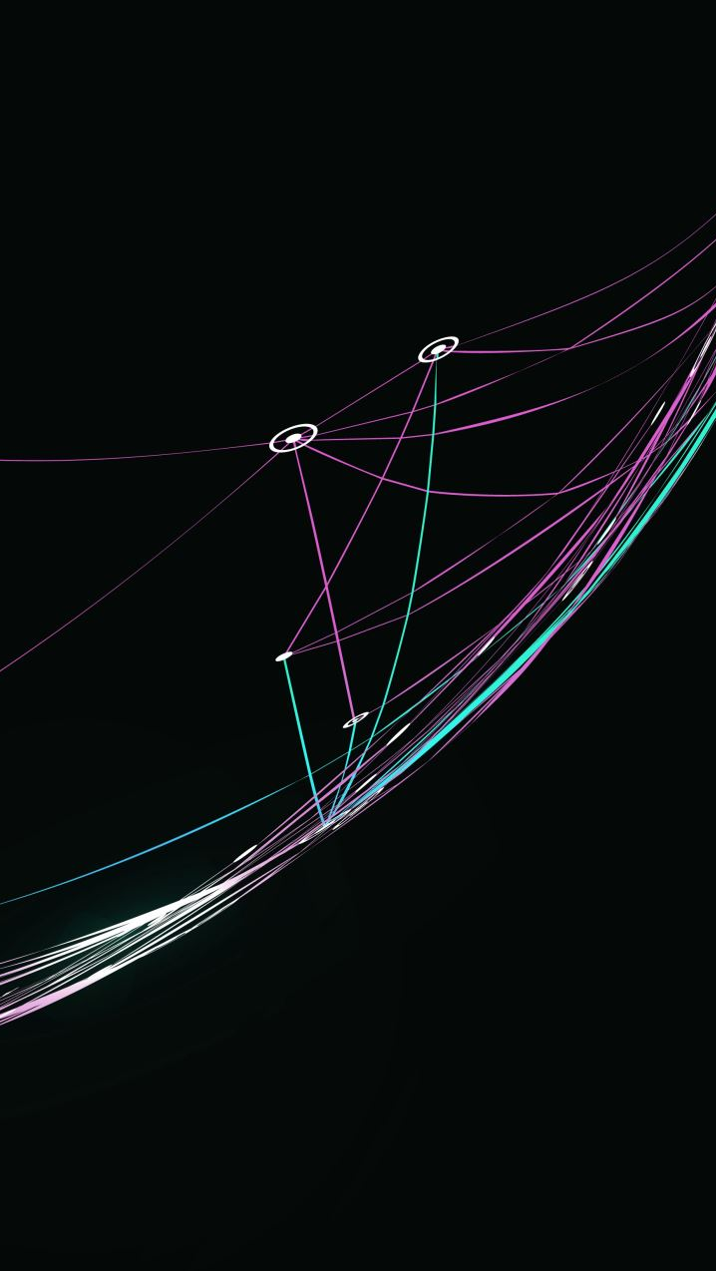
Organisational Strategy and Strategic Planning
FPA-SKPA Programme
GMME –SP 6
Lasantha Wickremesooriya
Consultant Strategist

Slide 2
The Decision Flow for Strategic Planning
Stakeholder analysis
Identifying Strategic Issues
Mandate
Aspirations
Environmental Analysis
Strategic Initiatives
Structure
Plan
of
Actions
Monitoring
&
Evaluation
Resources &
Capability Analysis
Feedback loop

Slide 3

Next Step
External Environment
Resources & Capabilities
Stakeholder Analysis
What are the important trends?
What is the impact/implications of these trends to our organisation?
What specialised resources & capabilities do we presently possess?
Given the emerging trends, what specialised resources & capabilities do we require?
Stakeholder engagement strategies

Slide 4
Summarise what the analysis reveals
What are the opportunities?
What are the challenges?
How does it affect achieving our mission?
What are the major initiatives we need to take?

Slide 5
Strengths ?
Opportunities ?
Challenges ?

Slide 6
Strategic Issues

Slide 7
What is your Institution's vision for success?
State Explicitly

Slide 8
Strategic Issues
What specific issues do we have to address (those arising from our analysis) in the next 3 years?
    Mandate?
    Environment ?
    Resources & Capabilities ?
    Stakeholders ?

Slide 9
Strategic Issues contd...
What do we wish to achieve in the next 3 years based on our mandate?
What gaps do we wish to bridge – between what we are now and what we wish to achieve?
    Reach ?
    Operations/Performance?
    Growth ?

Slide 10
Strategic Issues-List
Current issues that require prompt action -Immediate
Issues that are likely to require action in the near future
  Medium term – 1 to 2 years
  Long-term – 3 to 5 years
Issues that require no action at present but need to be continuously monitored?

Slide 11
Prioritising Issues
Phrase the issue as a question the organization can do something about and that has more than one answer
Current Issue | Medium term issue 1 to 2 years | Long term issue 3 to 5 years | Non critical issues
How can we find a source of sustainable funding?

Slide 12
Analysing the issues
Why is this an issue ?
How is it related to the organization’s environment or capabilities or stakeholders? (Strengths, opportunities & challenges)
How will it effect our mandate? or fulfilling our mission ?
What are the consequences of not addressing this issue? What makes it a priority?

