Slide 1
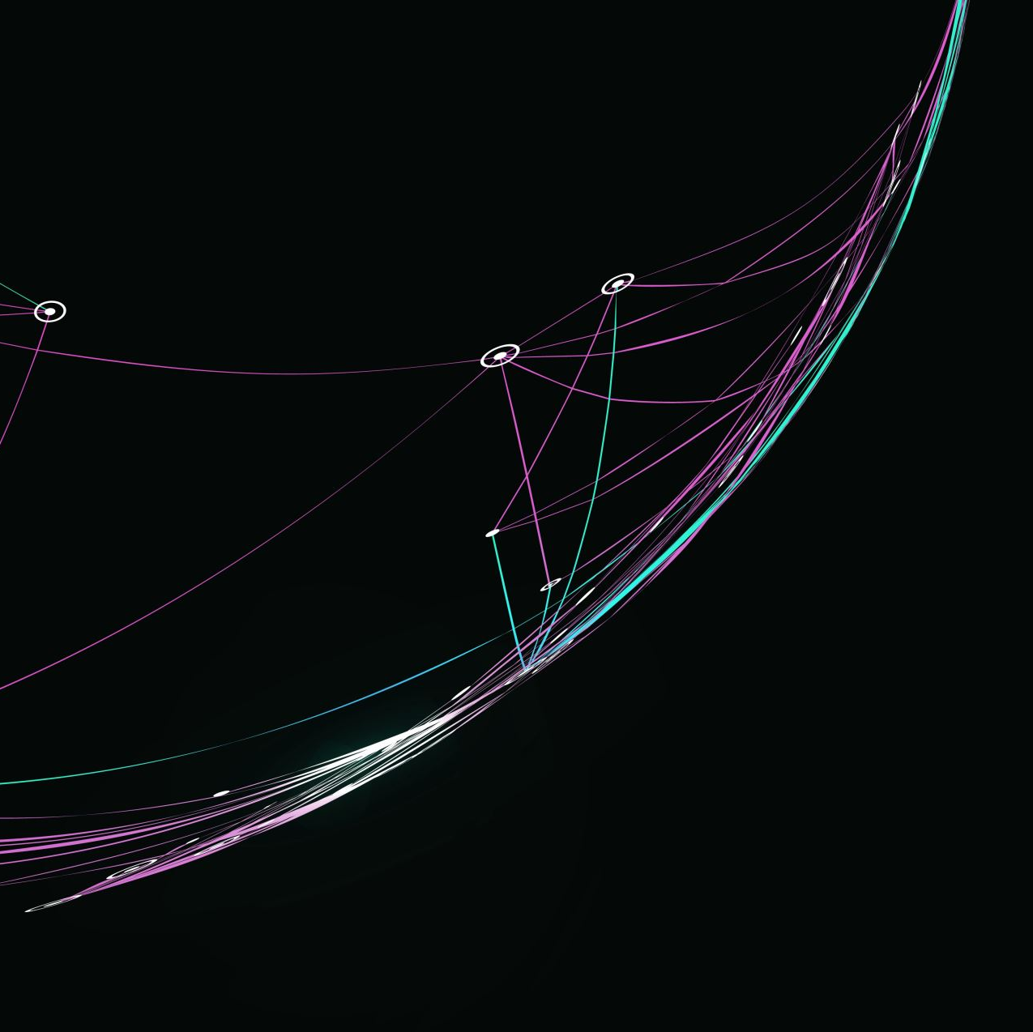
Organisational Strategy and Strategic Planning
FPA-SKPA Programme
GMME –SP 5a (Supplementary)
Lasantha Wickremesooriya
Consultant Strategist

Slide 2
OXFAM International
The future is equal

Slide 3
Aspirations
Vision
We have a vision of a just and sustainable world without poverty.
A world where people and the planet are at the centre of our economy. Where women and girls live free from violence and discrimination. Where the climate crisis is contained. And where governance systems are inclusive and allow for those in power to be held to account.
Mission
We fight inequality to end poverty and injustice
Purpose
We believe in the power of people. We offer them support to help relieve their suffering. We champion their causes and act together to transform lives and create change that lasts.

Slide 4
Values
We believe everyone has the right to be treated fairly and to have the same rights and opportunities.
We speak truth to power and act with conviction on the justice of our causes.
Equality
Solidarity
Empowerment
Inclusiveness
Accountability
Courage
We join hands, support, and collaborate across boundaries in working towards a just and sustainable world.
We take responsibility for our action and inaction and hold ourselves accountable to the people we work with and for
We embrace diversity and difference and value the perspectives and contributions of all people and communities in their fight against poverty and injustice.
We acknowledge and seek to expand people’s agency over their lives and the decisions that impact them.

Slide 5
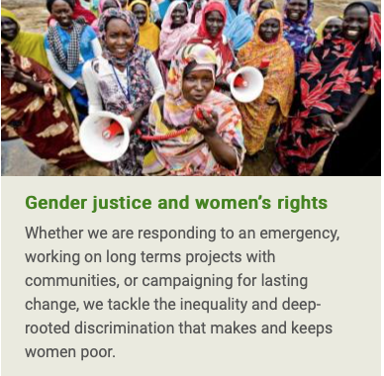
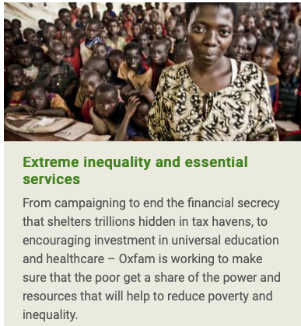
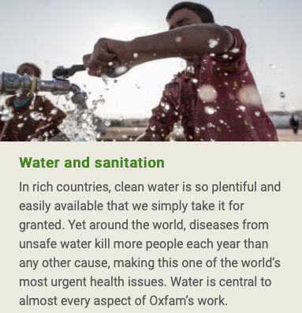
Strategic Issues

Slide 6
Reference: https://www.oxfam.org/en

Slide 7
Accelerating action on NCDs to promote health, protect rights and save lives

Slide 9
Partnership-driven
Human rights-based
Transparent and accountable
Independent
Values

Slide 10
Reference: https://ncdalliance.org

