Slide 1

Governance
FPA-SKPA Programme
GMME
Lasantha Wickremesooriya
Consultant Strategist

Slide 2

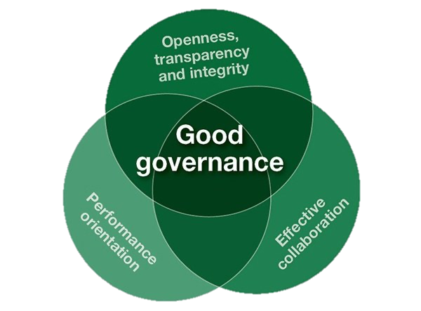
What is Governance ?

Slide 3
What is Governance ?
Governance covers everything from financial viability of the organization to fulfilling its mission successfully. It is the systems and processes by which owners/ members control and monitor the use of corporate assets

Slide 4
Not-for-Profit Governance
The process of providing strategic leadership to a non-profit organization. It entails the functions of setting direction, making policy and strategy decisions, overseeing and monitoring organizational performance, and ensuring overall accountability.

Slide 5
Not-for-Profit?

Slide 6
Profits earned are utilised for rewarding investors, grow investor wealth & organisational growth
For-Profit
Profit
Not-for-Profit
Profits earned are utilised to further the aims of the organisation

Slide 7

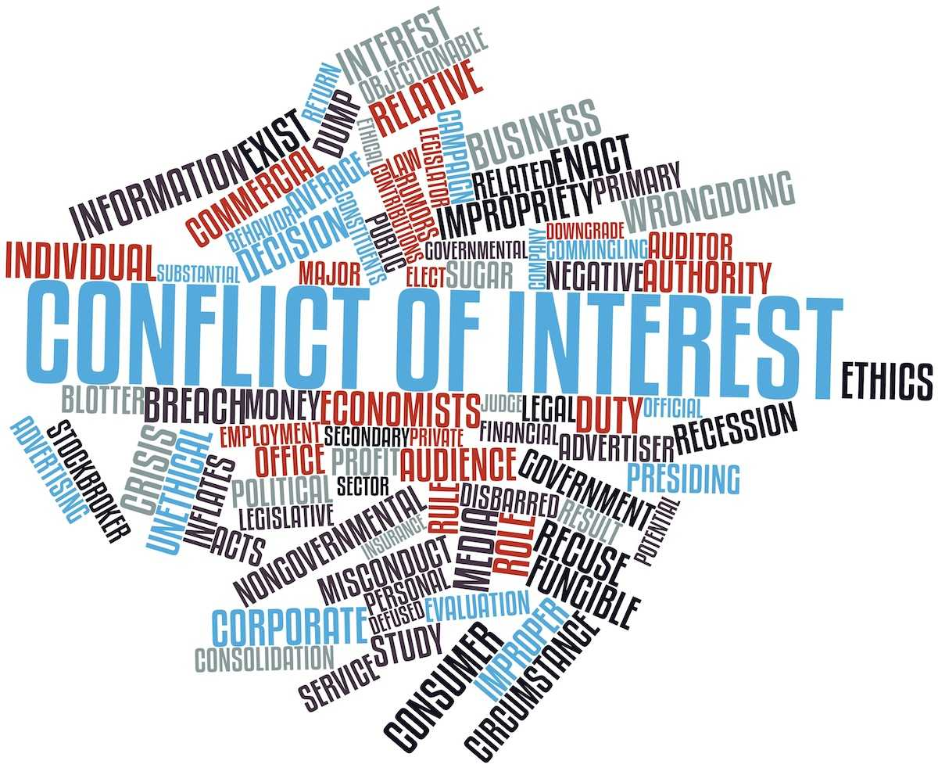
What problems does corporate governance try to solve ?

Slide 8

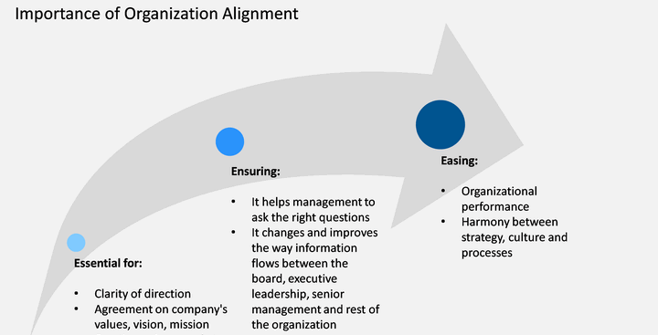

Slide 9

Members of the Society
Donors
Management

Slide 10
Benefits of good governance
Stability & Productivity
Performance Improvement
Risk reduction
Organisational Growth
Reputation
Trust

Slide 11
Governance
Purpose & Strategy
Roles & Responsibilities
Board Composition
Risk Management
Performance
Transparency & Accountability
Stakeholder Engagement
Conduct & Compliance
Culture
Governance Principles

Slide 12
Discussion

