Slide 1

Social Enterprises
FPA-SKPA Programme
GMME- Gov. 9
Lasantha Wickremesooriya
Consultant Strategist

Slide 2

What is a Social enterprise?
The running of an enterprise that uses its revenue or business model to achieve an economic, social, cultural or environmental mission that benefits the public or a particular community

Slide 3
Social enterpises
Led by an economic mission consistent with public benefit
Trade to fulfil their mission
Derive substantial portion of their income from trade
Reinvest the surplus in the fulfilment of the mission

Slide 4
Some issues to consider – A check list
Can you clearly describe the particular social, community or environmental mission of your enterprise?
What issue are you trying to address? How will your social enterprise contribute to resolving that issue?
Who will you need to work with? Who should you engage in designing your social enterprise?
Is anyone else already doing something similar? Is there room or need for another social enterprise in the space? If yes:
What can you learn from them?
Should you join them?
Where is the issue? Is it in one state, or is it across multiple states or territories? Where will the enterprise operate?
Where will your funding come from? Will you seek to access philanthropic grants? Do you want to attract investors? Will you be community-owned?
Who will oversee the enterprise and its operations? Will your enterprise have staff? Will your enterprise have ‘owners’ or ‘members’?
If you will have shareholders, will they be a small group of people connected to you, or will you run public campaigns to find lots of shareholders?

Slide 5
Social enterprise models
Direct benefit models
Operating a commerical venture where people employed are those that are part of a ‘focal’ group
Cross subsidy model
Provides services in direct response to a social or economic need and use profits to support access to those otherwise cannot afford them
Donation model
Profits earned from business operations donated to to other Not-for-Profit organisations

Slide 6

A Case Study
The Aravind Eye Hospital

Slide 7
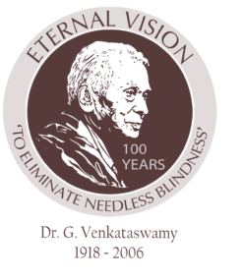
“Intelligence and capability are not enough. There must be the joy of doing something beautiful”
Dr. Govindappa Venkataswamy

Slide 8
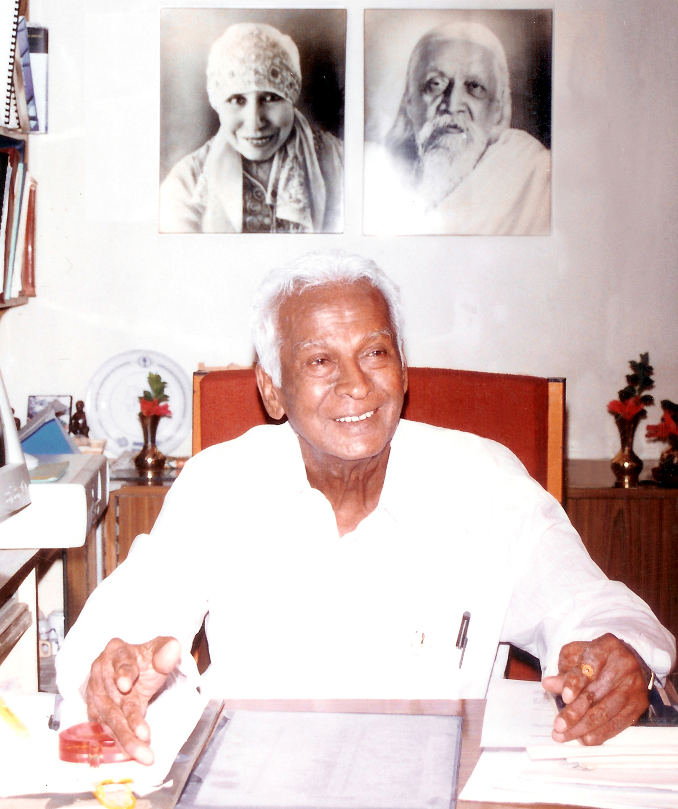
if Coca-Cola could sell billions of sodas and McDonald’s, billions of burgers, why can’t Aravind sell millions of sight-restoring operations?

Slide 9
“Quality Doesn’t Mean Expensive Neither Does Cheap Mean Poor
Quality”

Slide 10
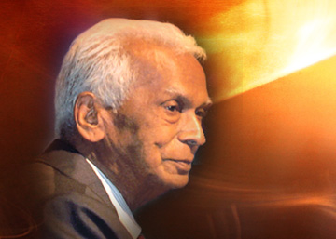
Daily meditation
There is a power within that knows beyond our knowing’s. We are greater than our thoughts.
Inspiration from Sri Aurobindo and the mother.
His experience drove him to start Aravind with a single minded mission-
Eliminate needless blindness
Life experiences of tragedies in the family, then struck by rheumatoid arthritis & bedridden for 2 years, and ended up as an Ophthalmologist instead of a obstetric.

Slide 11
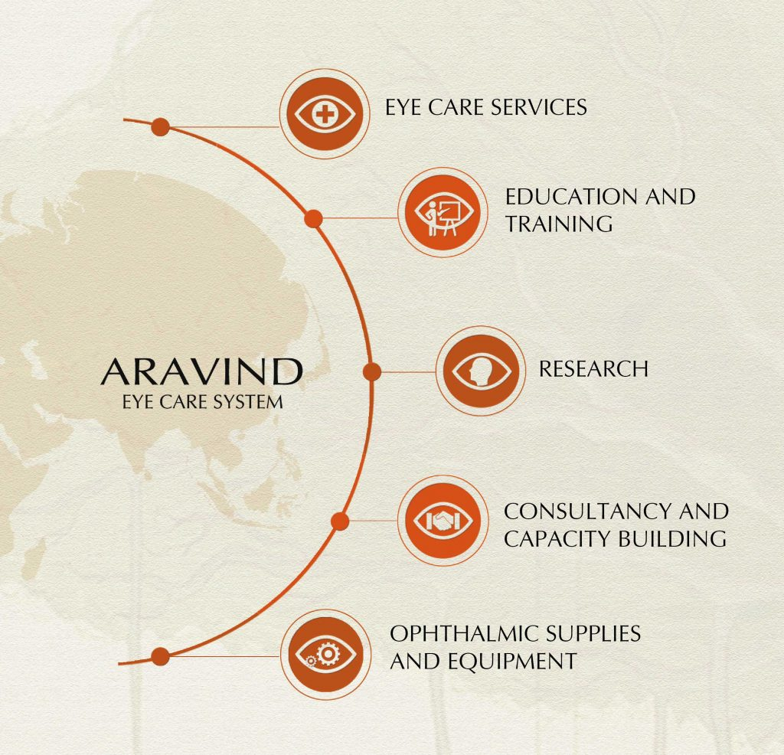
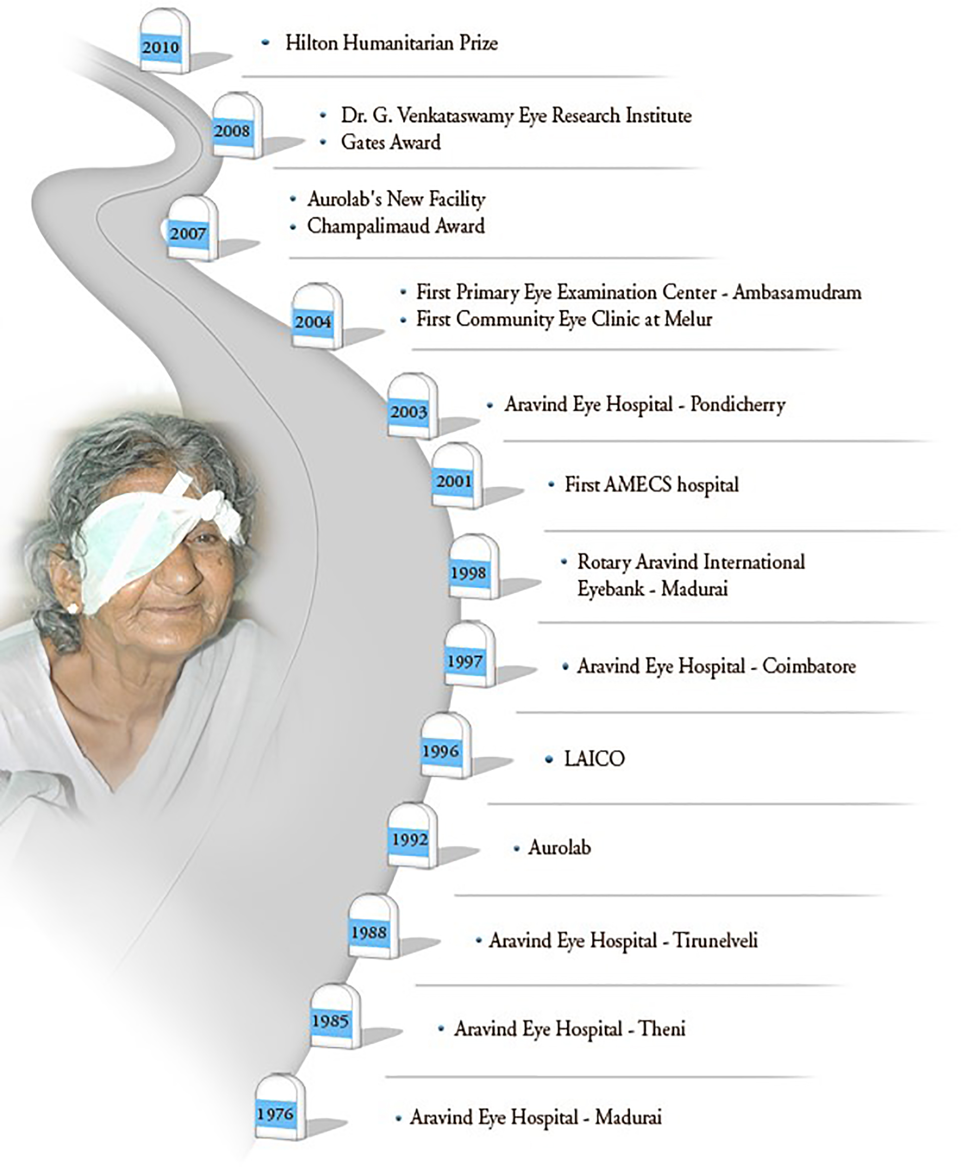

Slide 12
Dr. Govindappa Venkataswamy – The journey
Born in 1918 to a farming family – eldest
Graduated as Docotor of medicine from Madras University in 1944 and joined the Indian Army Medical corps
Discharges in 1948 due to rheumatoid arthritis ; bed riden for a year; could not hold a pen to write!
Dr.V did not give up. Trained himself and finally could hold a scalpel used for surgery
By 1976 (retired from Govt. Hospital in Madurai) he could perform 50 eye surgeries a day, standing

Slide 13
Dr. Govindappa Venkataswamy – The journey
Commences Aravind eye hospital in 1976 – 11 beds ( 6 free and 5 for paying)
His sister, Brother-in –law and himself are the first three Doctors
1978 – 70 bed free hospital is opened to treat the poor
1981 – completes a 250 bed, hospital for paying patients
1984 – 350 bed free hospital

Slide 14
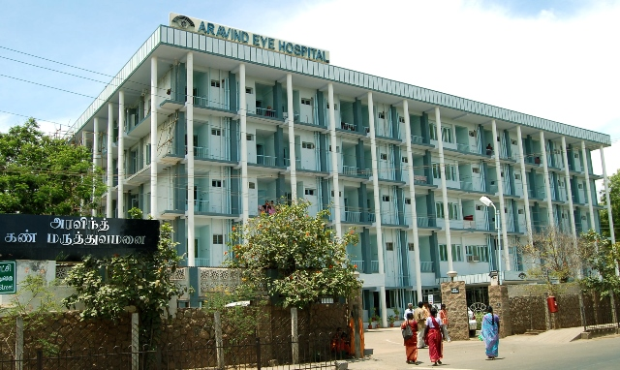
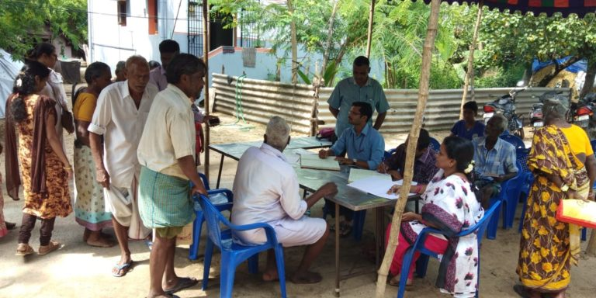
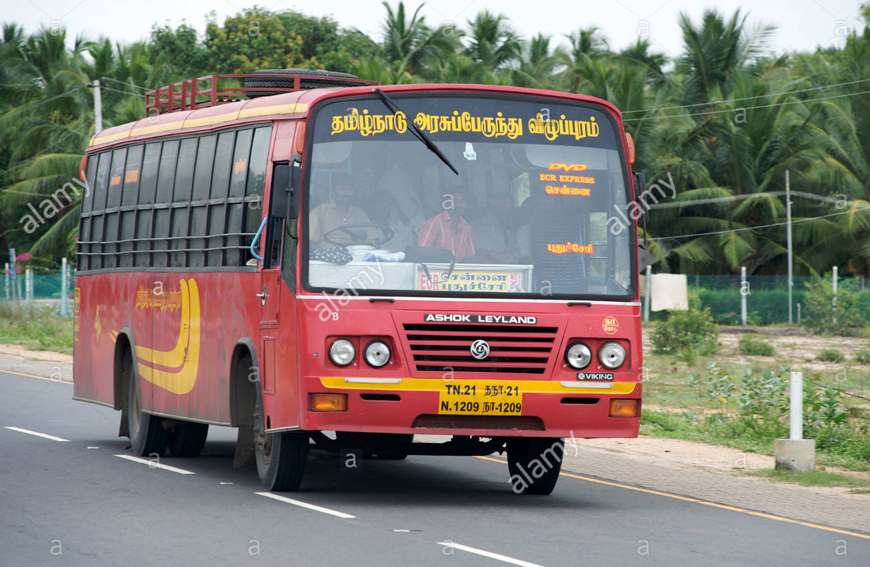
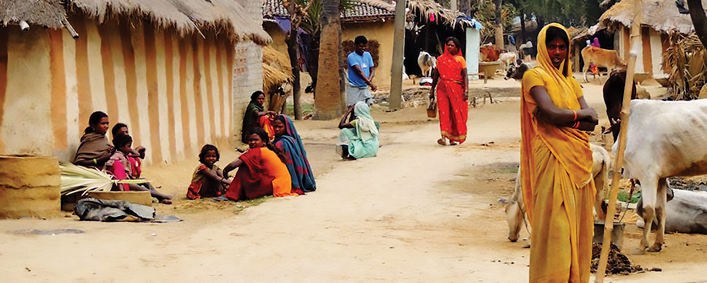
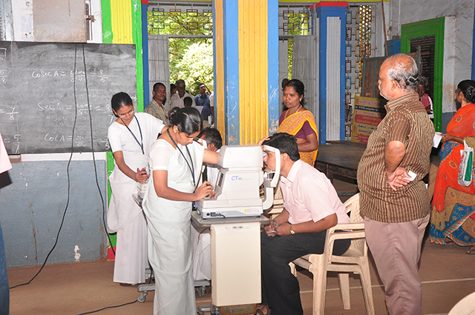
3 days
Eye camps held across the country – screen and those selcted for surgery are transported to Madurai the same afternoon
Follow up by Aravind nursing team after 3 months

Slide 15
Dr. Govindappa Venkataswamy – The journey
All construction work carried out by Dr V’s brother a civil engineer at cost. He later becomes the finance manager
Dr Vs nephew joins as the hospital administrator
Research & training collaboration with St. Vincent’s hospital, NY and Illinoi’s Eye and Ear Infirmatory, Chicago –for Opthamalogists
Nurses and support staff trained continuously
To the poor:
  free transportation to the base hospital, accommodation, food, medicine and transport fare to return to their village

Slide 16
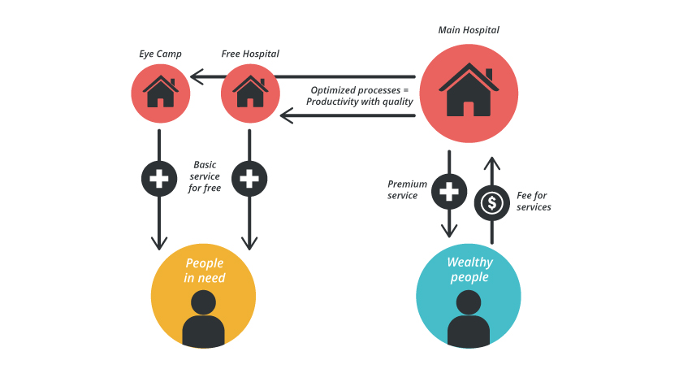
It is run like a McDonald’s, with assembly-line efficiency, strict quality norms, brand recognition, standardization, consistency, ruthless cost control and above all, volume.

Slide 17
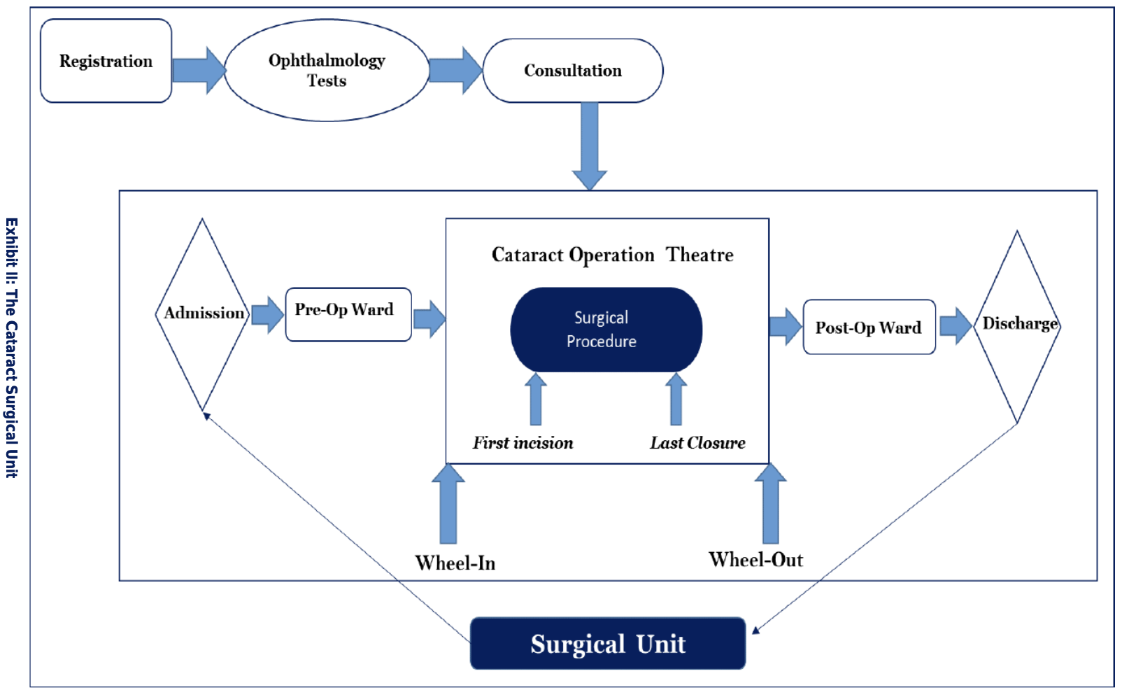

Slide 18
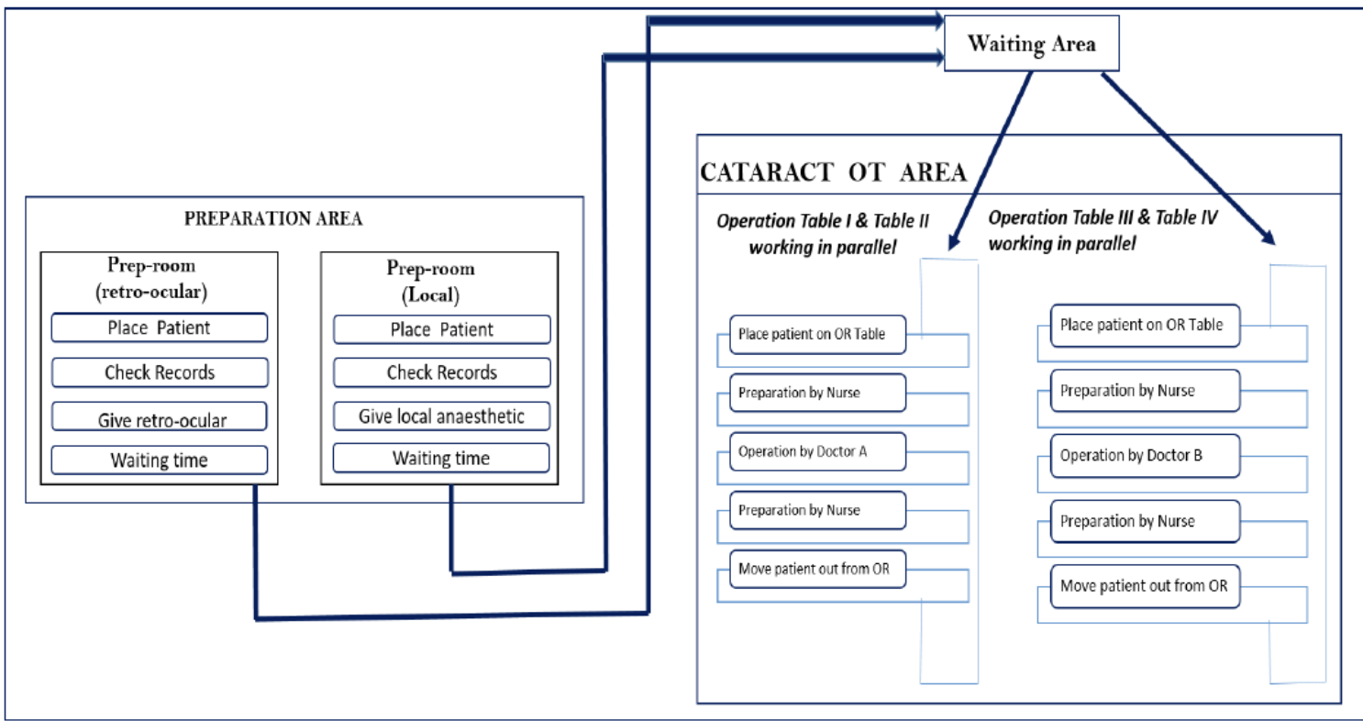

Slide 19
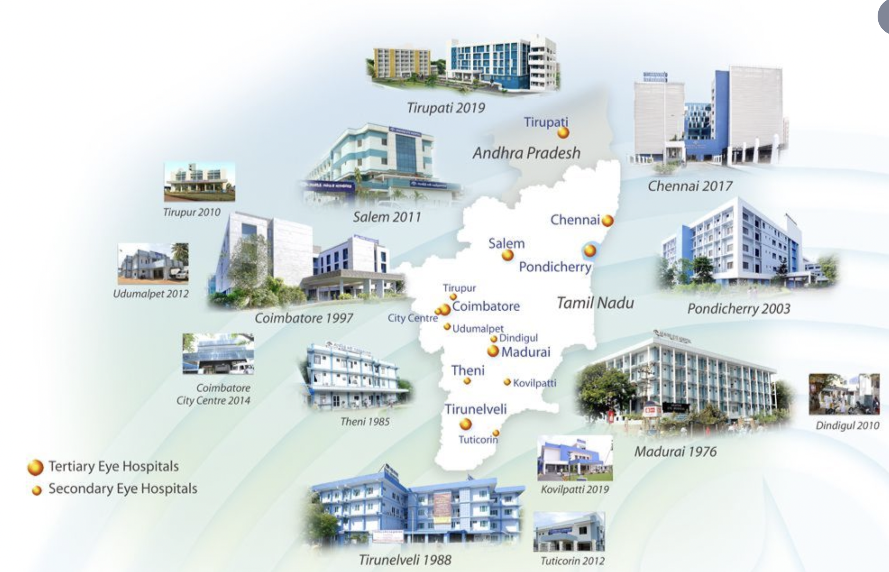
14 eye hospitals
6 outpatient eye examination centres
94 primary eye care facilities in South India

Slide 20
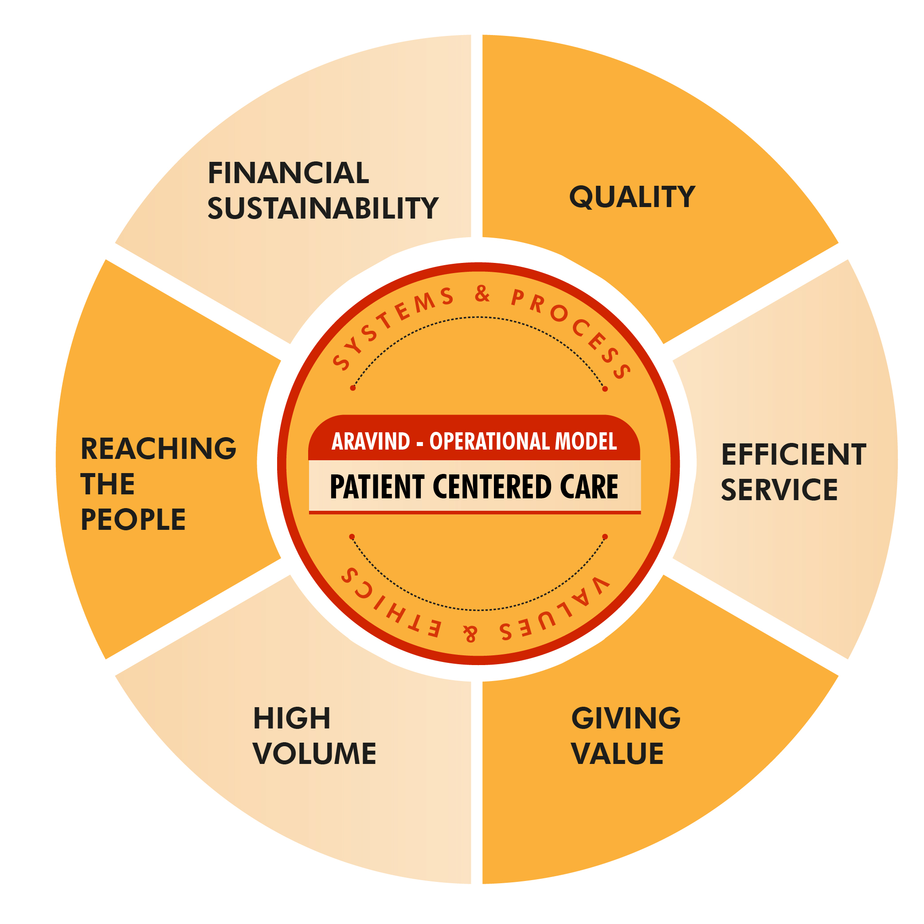
Prosocial cost benefit analysis
50% of its patients receive services either free of cost or at steeply subsidized rate
all patients are accorded the same high-quality care and service, regardless of their economic status
A critical component of Aravind’s model is the high patient volume, which brings with it the benefits of economies of scale.

Slide 21
Hybrid Business Model – The hybrid model helps Aravind use the cash-flows from paying patients to cross-subsidize services for the needy. This model helped Aravind develop specialty services along with basic cataract surgery and care. The ability to develop high-end ophthalmic care also helped Aravind attract and retain qualified doctors
- High volume, high quality and low cost
- Reaching out to the under-served
Deep spiritual aspiration + best practices of business
“We just have to do the work. The money will follow.” Dr V
Integrative Thinking

