Slide 1

Conflict resolution
FPA-SKPA Programme
GMME- Gov. 6
Lasantha Wickremesooriya
Consultant Strategist

Slide 2

Conflict emerges from …
Communication differences;
  misunderstandings, different interpretations of the same information, noise
Structural differences;
  role ambiguity: coordination, responsibilities
Personal differences
  Cultural gap
  Personal differences in values, goals, or styles

Slide 3
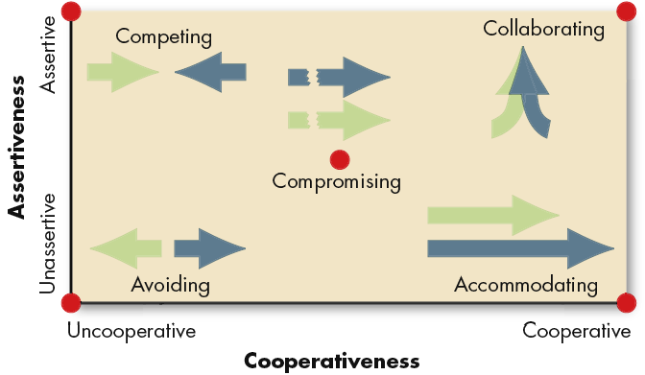
Dimensions of Conflict-Handling Intentions
Source: K. Thomas, “Conflict and Negotiation Processes in Organizations,” in M.D. Dunnette and L.M. Hough (eds.), Handbook of Industrial and Organizational Psychology, 2nd ed., vol. 3 (Palo Alto, CA: Consulting Psychologists Press, 1992), p. 668. .

Slide 4
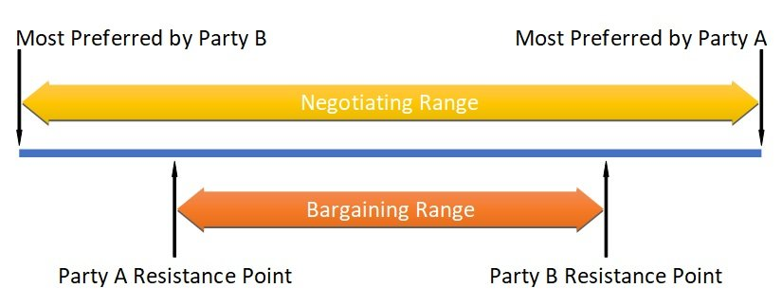
5,250,000/=
6,500,000/=
5,500,000/=
5,750,000/=

Slide 5
Ways of Dealing with Conflict
Avoidance
  Does not deal with issues at hand
  Lose-lose strategy
    Use: when conflict is trivial or emotions are running high and need to cool down!
Accommodation
  Agreement through yielding or conforming to the positions of others
  Lose-win strategy
    Use: when maintaining harmonious relationships are required; where the issues are not important to you

Slide 6
Ways of Dealing with Conflict
Competition/Forcing
  Offensive aggressive approach
  Win-lose/lose-win strategy
    Use: where a quick resolution is needed
Compromise
  Involves a search for a solution which is mutually acceptable
  Lose-lose strategy
    Use: when desirous of achieving a temporary solution or time pressure demand a speedy solution

Slide 7
Ways of Dealing with Conflict
Collaboration
  Total-membership approach, generates creative solution
  Win-win strategy
    Use: where the issue is too important to be compromised, time pressures are minimal, and all parties want to satisfy their interests

Slide 8
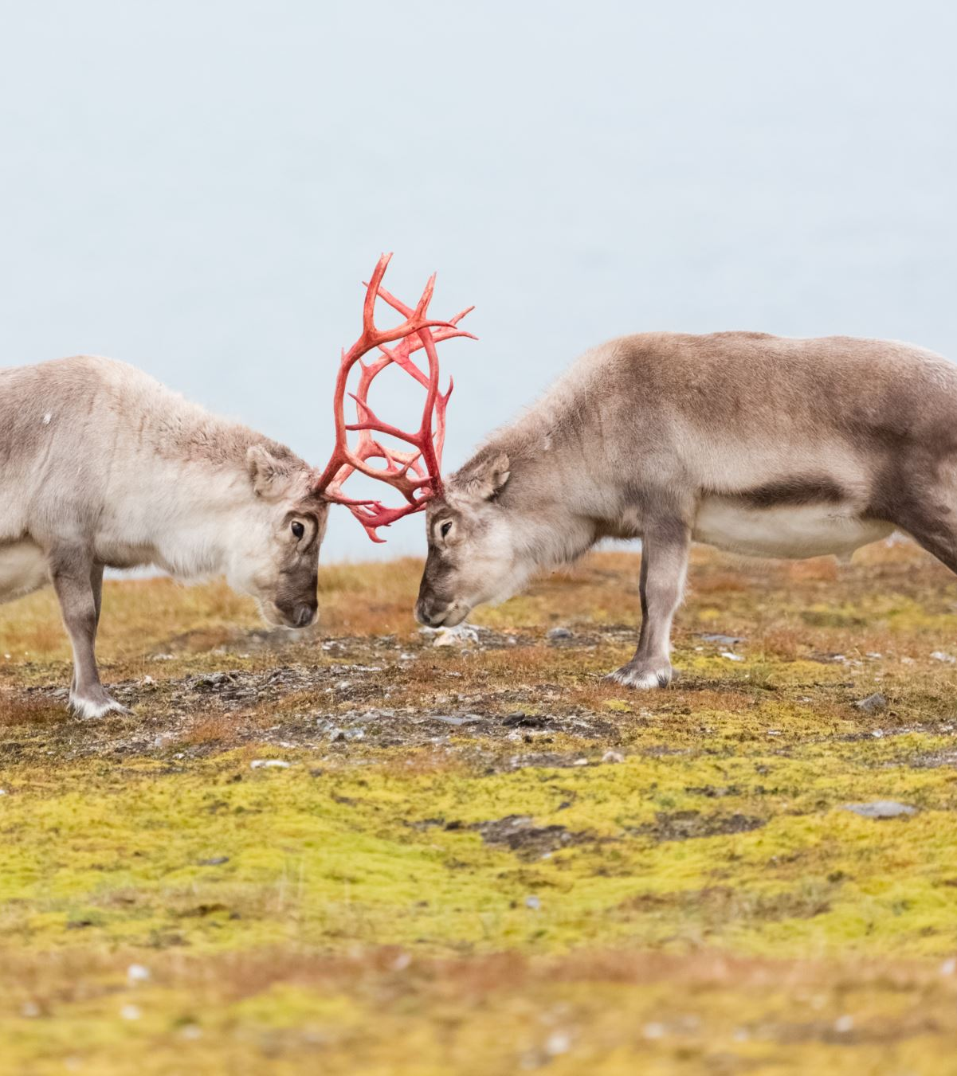
Conflict Resolution?

Slide 9
What are the skills required?
Use of goal setting
Reduces ambiguity
Specific
Effective Listening and feed back
Effective communication
Reduces distortion
Improves accuracy
Persuasion
Get the other to do what you want, without using formal authority

Slide 10
Bargaining Strategies
Integrative Bargaining
Negotiation that seeks one or more settlements that can create a win-win solution
An organisations requests for a budget of US$ 5000 for a project
The donor refuses to fund the total amount due to bad track record
The Board and the Donor sit down to find a solution

Slide 11

Distributive Vs Integrative Bargaining
Bargaining Distributive Integrative
Characteristic Bargaining Bargaining
Goal Get as much of pie Expand the pie
as possible
Motivation Win-Lose Win-Win
Focus Positions Interests
Information Low High
Sharing
Duration of Short term Long term
relationships
Source: Based on R. J. Lewicki and J. A. Litterer, Negotiation (Homewood, IL: Irwin, 1985), p. 280.

Slide 12
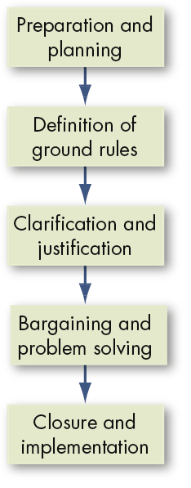
The Negotiation Process
History, target audience, cultures, your goals, other party goals, time frames
Negotiators? Venue, time constraints, limitations (on issues to be negotiated) procedure in the event of an impasse
Amplify, clarify, justify demands/issues
The Give and Take process
Finalise agreement, agree on way forward/implementation and monitoring

Slide 13
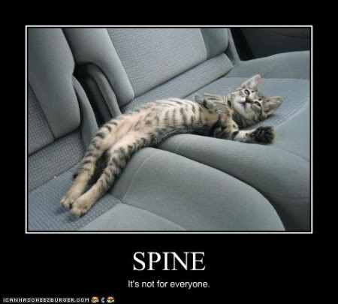
“Let us never negotiate out of fear”
“But let us never fear to negotiate”
-John F. Kennedy

