Slide 1
Aspirations
Workshop 1 to 3

Slide 2
Purpose

Slide 3
Why is the work you do important?

Slide 4
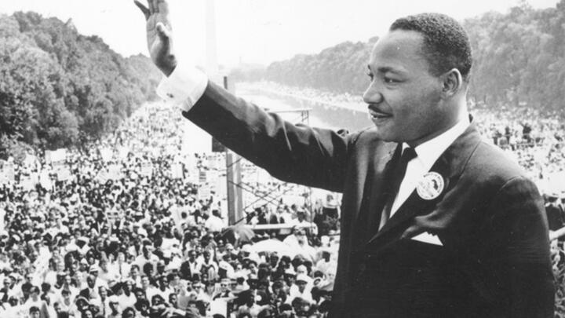
“I have a dream that one day on the red hills of Georgia the sons of former slaves and the sons of former slave owners will be able to sit down together at a table of brotherhood”
Martin Luther king Jnr ii
African American Civil Rights Movement

Slide 5
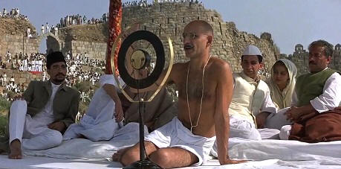
“English factories make the cloth that makes our poverty.”
Mahatma Gandhi
Leader of Nationalist Movement against British rule in India

Slide 6
We rehabilitate drug addicted people and uplift their living in the society
What?
The
Golden
Circle
How?
By conducting mentoring programmes, counselling and skills development activities …
Why ?
???

Slide 7
We rehabilitate drug addicted people and uplift their living in the society
What?
The
Golden
Circle
How?
By conducting mentoring programmes, counselling and skills development activities …
Why ?
Creating physical and emotionally healthy society

Slide 8
Purpose statement- Criteria
What is the contribution to society ?
Does it answer the question – Why is this work important?
Is it inspirational and motivational?
Does it use powerful words?
Is it brief in length so staff will remember it?

