Slide 1

Aspirations
GMME: Workshop 1 to 3

Slide 2

Mission

Slide 3
Mission statements
Institution | Mission
ECDIC | “Influencing the change to reduce the social Injustices and enhance economic, social & health conditions of marginalized groups as well as engaging peace, coexistence and environment conservation”
GMME | To provide the best possible service to the country directly or through the member YMMAs by mobilizing the origination resources with the objective of raising the economic standards of the have-nots. Alleviating poverty, training and guiding the youth to be good citizens with education as the primary objective and to play a dominant role in settling community issues, social justice and promoting inter communal amity
LP | “Creating a safe and Nurturing environment for PLHIVs in Sri Lanka through increased HIV awareness, access to medication, reducing stigma, and contributing to the national health policy”
MMM | “We have made it our firm obligation to provide our best efforts to gift all individuals, irrespective of age, gender, nationality, religion, race or any other differences, the capacity to lead an inspiringly superior and a healthy lifestyle in accordance to the norms of nature and the laws of the state”

Slide 4
Mission statements
Institution | Mission
OECRP | “To uphold & ensure the equal opportunities of the children, youth, women and disadvantaged and marginalized communities by implementing participatory mobilization programs in order to contribute for the total sustainable development in Sri Lanka.”
PH | උපදේශණය ලබාදීම , ආර්ථිකය ශක්තිමත් කිරීම සඳහා පුහුණුව සහ අධ්‍යාපනය තුලින් ධාරිතා වර්ධනය කිරීම, සහයෝගය සහ සහන ලබාදීම
SARD | රාජ්‍ය, පෞද්ගලික හා පොදු යන සියලු අංශයන් වලට තාක්ෂණික හා දැනුම සැපයීම මගින් සෞක්‍ය හා යහ පැවැත්මේ ක්‍රියාවලියට හවුල්කරුවන් වීම අපගේ මෙහෙවරයි.

Slide 5
Mission statements
A good Vision and Mission will complement each other
Mission is what you actually do today as a service
The Mission explains how this Vision is being achieved and what the company actually does

Slide 6
Mission elements
What you do
Why you do it
How you do it
Where you do it
Who you do it for
How it makes you feel
A good Mission statement does not have to include all of the above, but it should at least be covering the What and Why

Slide 7

To provide advice and support to empower anyone experiencing a mental health problem. We campaign to improve services, raise awareness and promote understanding.

Slide 8
To provide advice and support to empower anyone experiencing a mental health problem. We campaign to improve services, raise awareness and promote understanding.
What you do
Why you do it
Who you do it for
How you do it

Slide 9
රාජ්‍ය, පෞද්ගලික හා පොදු යන සියලු අංශයන් වලට තාක්ෂණික හා දැනුම සැපයීම මගින් සෞක්‍ය හා යහ පැවැත්මේ ක්‍රියාවලියට හවුල්කරුවන් වීම අපගේ මෙහෙවරයි
Who you do it for
SARD
How you do it
Why you do it
How it makes you feel

Slide 10
To provide the best possible service to the country directly or through the member YMMAs by mobilizing the origination resources with the objective of raising the economic standards of the have-nots. Alleviating poverty, training and guiding the youth to be good citizens with education as the primary objective and to play a dominant role in settling community issues, social justice and promoting inter communal amity
YMMA
How you do it
What you do
Where you do it
Why you do it
Who you do it for
Why you do it

Slide 11
උපදේශණය ලබාදීම , ආර්ථිකය ශක්තිමත් කිරීම සඳහා පුහුණුව සහ අධ්‍යාපනය තුලින් ධාරිතා වර්ධනය කිරීම, සහයෝගය සහ සහන ලබාදීම
What you do!
Positive Hopes Alliance

Slide 12

Take a few minutes to review your own Mission statement
How many elements have you addressed?

Slide 13
Mission elements
What you do
Why you do it
How you do it
Where you do it
Who you do it for
How it makes you feel
A good Mission statement does not have to include all of the above, but it should at least be covering the What and Why

Slide 14

Values

Slide 15
Why do we need values?
Values drives the behaviours of organisations
The way you interact with:
  team members
  with stakeholders
  With members
  with society, should be driven by your Institution's core values.
Your values should be unique to you
They are closely related to your organisation’s culture and belief systems

Slide 16
What are our values?
Ask questions
How do stakeholders perceive you?
How do you want society to perceive you?
What are you proud about as a team?
What matters most to your organisation?
How would you describe your culture?

Slide 17
ECDIC
Equality for all
Fairness for all marginalized groups
Team work
Accountability
Humility
Transparency
Self Respect
Leadership
Knowledge Sharing with others
Trustworthiness
Honestly work with community (Honesty)
Employee Advocacy
Past Experience

Slide 18
Take a few minutes to review your own Values
Do they resonate with your culture and beliefs?

Slide 19
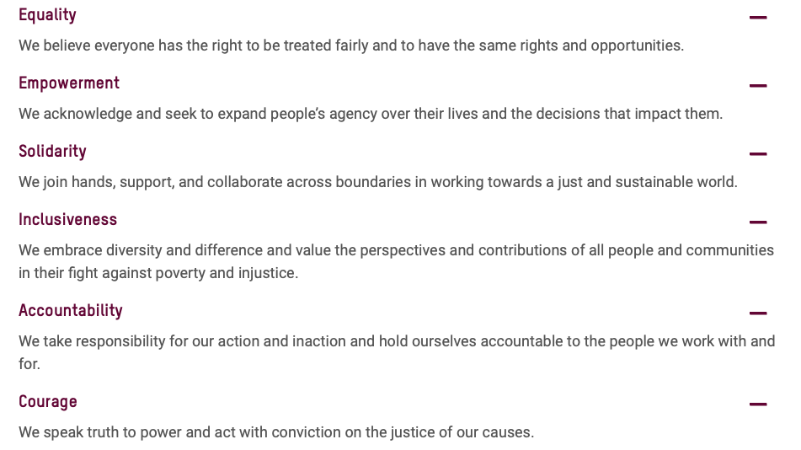


Slide 20
Examples of Values
Innovative
Transparent
We are open
We are personal
Collaborative
Compassionate
Inclusive
Caring
Integrity
Safety
Service
Teamwork
Accountability
Kindness
Diversity
Winning together

