Slide 1

Monitoring & Evaluation
FPA-SKPA Programme
GMME- M&E 1
Lasantha Wickremesooriya
Consultant Strategist

Slide 2
M&E Defined
Monitoring
Continuous
Ensures project on track
Identifies problems
Evaluation
Assesses whether project is achieving objectives
Periodic
Focuses on outcomes and impacts
Notes:
SLIDE CONTENT: According to the World Bank, monitoring is a continuous internal management activity to ensure that project implementation is on track. It involves measuring inputs, activities and outputs, assessing whether they are contributing to achieving the project’s objectives and identifying any existing or potential problems. It helps ensure that the project achieves its defined objectives within a prescribed time frame and budget.
According to the World Bank, evaluation is the process of assessing whether a project is achieving its intended objectives. This may be done periodically by internal managers or by external actors. Evaluation focuses on outcomes and impacts and assesses whether they are contributing to achieving program goals and objectives.
TRAINER NOTE: Let participants know that monitoring and evaluation can also be applied to policy implementation but that the focus of this session will be on monitoring and evaluating projects and programs. More on the basics of M&E can be found in the introduction to M&E presentation in this module.
Ask participants what exposure they have had to monitoring and evaluation in the past. What kinds of tools have they used to monitor and evaluate programs that they have worked on?
For more information on M&E from the World Bank, see the following online training program: http://info.worldbank.org/etools/docs/library/192862/Module4/Module4a.html

Slide 3
Why do you need
M & E?
Define
Define the desired impact of the research team’s stakeholder engagement activities on different projects
Justify
Justify the need and budget for these stakeholder engagement activities.
Increase
Increase the rigor of stakeholder engagement programs, including the potential need to change your strategy and action planning.
Establish
Establish your accountability with the stakeholders

Slide 4
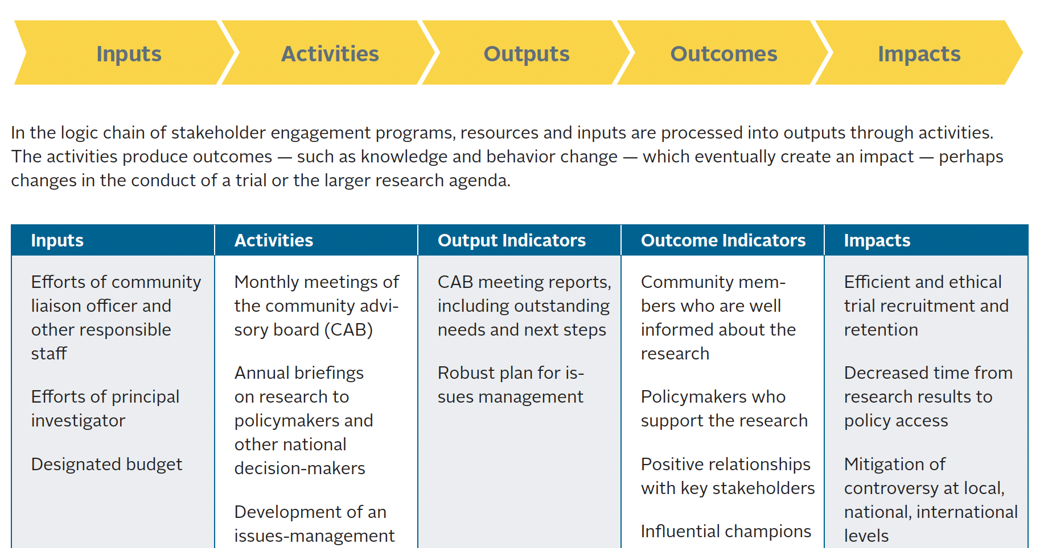

Slide 5
Complementary Roles of Monitoring and Evaluation
Monitoring
Clarifies program objectives
Links activities and their resources to objectives
Translates objectives into performance indicators and sets targets and baseline
Routinely collects data on these indicators, compares actual results with targets
Reports progress to managers and alerts them to problems
Evaluation
✓ Analyzes why intended results were or were not achieved
✓ Assesses specific causal contributions of activities to results
✓ Examines implementation process
✓ Explores unintended results
✓ Provides lessons, highlights significant accomplishment or program potential, and offers recommendations for improvement

Slide 6
Developing an M & E framework
Determine
Determine who will receive evaluation data
Sponsors? Funders? Community? Stakeholders? Members?
How do you ensure the information will be useful for internal program monitoring purposes?
Map
Map your stakeholder engagement work plan
Prioritize
Prioritize what to evaluate
Select
Select indicators
Decide on
Decide on an approach to measurement
Identify
Identify data collection methods

Slide 7
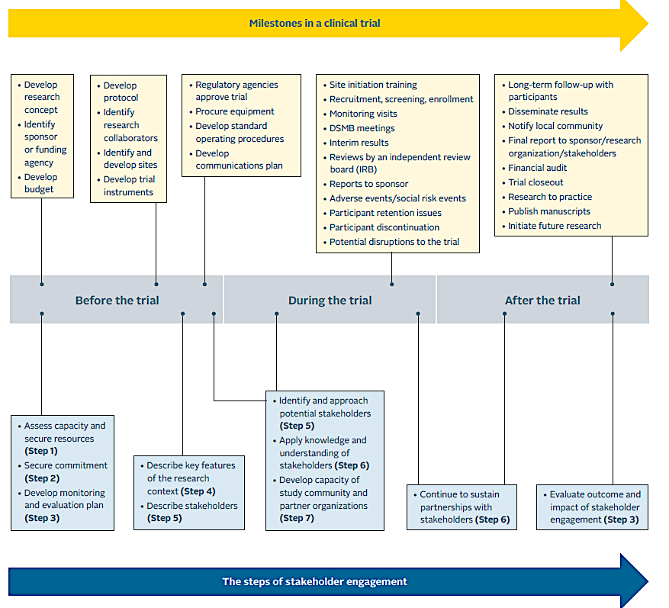
Mapping your Project: Illustration

Slide 8
Ten Steps to Building a Results-Based M&E System

Slide 9
Conducting a Readiness Assessment
planning for improvement :
selecting realistic targets
selecting key indicators to monitor outcomes
using
evaluation information
using findings
1
2
3
4
5
6
7
8
9
10
sustaining the
M&E system
within the organization
agreeing
on outcomes to monitor and evaluate
gathering
baseline data
on indicators
monitoring
for results
reporting findings

Slide 10
Step 1: Conducting a Readiness Assessment
Conducting a Readiness Assessment
planning for improvement :
selecting realistic targets
selecting key indicators to monitor outcomes
using
evaluation information
using findings
1
2
3
4
5
6
7
8
9
10
sustaining the
M&E system
within the organization
agreeing
on outcomes to monitor and evaluate
gathering
baseline data
on indicators
monitoring
for results
reporting findings

Slide 11
What Is a Readiness Assessment?
A systematic approach to determine the capacity and willingness of an organization to construct a results-based M&E system
  The approach focuses on: presence or absence of champions, incentives, roles and responsibilities, organizational capacity, and barriers to getting started

Slide 12
Step 2: Agreeing on Outcomes to Monitor and Evaluate
selecting key indicators to monitor
outcomes
planning for improvement :
selecting realistic targets
conducting a readiness assessment
using
evaluation information
using findings
1
2
3
4
5
6
7
8
9
10
Agreeing
on Outcomes to Monitor and Evaluate
gathering
baseline data
on indicators
reporting findings
sustaining the
M&E system
within the organization
monitoring
for results

Slide 13
Developing Outcomes
Outcomes:
Indicators:
Baseline:
Targets:
1. Improved coverage of HIV programs
2. Improved awareness of safety measures

Slide 14
Step 3: Selecting Key Indicators to Monitor Outcomes
Selecting Key Indicators to Monitor Outcomes
planning for improvement :
selecting realistic targets
conducting
a readiness assessment
using
evaluation information
using findings
1
2
3
4
5
6
7
8
9
10
agreeing on
outcomes to
monitor and evaluate
gathering
baseline data
on indicators
monitoring
for results
reporting findings
sustaining the
M&E system
within the organization

Slide 15
Developing Outcomes
Outcomes:
Indicators:
Baseline:
Targets:
1. Improved coverage of HIV programs
Number of field level camps per month
Increase in usage of protective care by population
2. Improved awareness of safety measures

Slide 16
Indicator Development
“CREAM”
  Clear
  Relevant
  Economic
  Adequate
  Monitorable

Slide 17
Matrix for Building/Using Indicators
Indicator | Data source | Data collection method | Who will collect data | Frequency of data collection | Cost to collect data | Difficulty to collect | Who will analyze and report data | Who will use data
1.
2.
3.
4.

Slide 18
Developing Indicators
Develop your own indicators to meet your needs
Developing good indicators usually takes more than one try
State all indicators neutrally – not “increase in…” or “decrease in…”
Pilot, Pilot, and Pilot!

Slide 19
Step 4: Gathering Baseline Data on Indicators
selecting key indicators to monitor
outcomes
planning for improvement :
selecting realistic targets
conducting a readiness assessment
using
evaluation information
using findings
1
2
3
4
5
6
7
8
9
10
agreeing on
outcomes to
monitor and evaluate
Gathering
Baseline Data
on Indicators
monitoring
for results
reporting findings
sustaining the
M&E system
within the organization

Slide 20
Baseline Data and Sources
Baseline data:
  Measurements to find out - where are we today?
Primary source:
  gathered specifically for the project
Secondary source:
  collected for another purpose
  can save money but be careful to ensure that it is truly the information you need

Slide 21
Key Informant
Interviews
Panel
Surveys
Conversation
with
Concerned
Individuals
Focus
Group
Interviews
Participant
Observations
One-Time
Surveys
Community Interviews
Direct
Observations
Censuses
Reviews of Official Records (MIS and admin data)
Field
Experiments
Field
Visits
Surveys
Informal/Less Structured Methods
Formal/More Structured Methods

Slide 22
Developing Outcomes
Outcomes:
Indicators:
Baseline:
Targets:
1. Improved coverage of HIV programs
Number of field level camps per month
16 field level camps per month
Increase in usage of protective care by population
Percentage usage is 62% amongst population
2. Improved awareness of safety measures

Slide 23
Step 5: Planning for Improvement: Selecting Realistic Targets
Planning for Improvement :
Selecting Realistic Targets
selecting key indicators to monitor
outcomes
conducting a readiness assessment
using
evaluation information
using findings
1
2
3
4
5
6
7
8
9
10
agreeing on outcomes to
monitor and evaluate
gathering
baseline data
on indicators
monitoring
for results
reporting findings
sustaining the
M&E system
within the organization

Slide 24
Identifying Expected or Desired Level of Improvement Requires Targets
Target Performance
Desired level of performance to be reached within a specific time
Desired Level of Improvement
Assumes a finite and expected level of inputs, activities, and outputs
Baseline Indicator Level
+
₌

Slide 25
Developing Outcomes
Outcomes:
Indicators:
Baseline:
Targets:
1. Improved coverage of HIV programs
Number of field level camps per month
16 field level camps per month
20 field level camps per month
Increase in usage of protective care by population
Percentage usage is 62% amongst population
Percentage usage of 77% by 2023 amongst population
2. Improved awareness of safety measures

Slide 26
Caution:
It takes time to observe the effects of improvements, therefore:
  Be realistic when setting targets
  Avoid promising too much and thus programming yourself to fail

Slide 27
Step 6: Monitoring for Results
selecting key indicators to monitor
outcomes
planning for improvement :
selecting realistic targets
using
evaluation information
conducting a readiness assessment
using findings
1
2
3
4
5
6
7
8
9
10
agreeing on outcomes to
monitor and evaluate
gathering
baseline data
on indicators
Monitoring for Results
reporting findings
sustaining the
M&E system
within the organization

Slide 28
Key Types of Monitoring
Impacts
Results
Results Monitoring
Outcomes
Outputs
Implementation
Activities
Implementation Monitoring
Inputs

Slide 29
Implementation Monitoring Links to Results Monitoring
Monitor
results
Means and Strategies
(Multi-year and Annual Work Plans)
Means and Strategies
(Multi-year and Annual Work Plans)
Means and Strategies
(Multi-year and Annual Work Plans)
Monitor
Implementation

Slide 30
Step 7: Using Evaluation Information
selecting key indicators to monitor
outcomes
planning for improvement :
selecting realistic targets
Using Evaluation Information
conducting a readiness assessment
using findings
1
2
3
4
5
6
8
9
10
7
agreeing on outcomes to monitor and evaluate
gathering
baseline data
on indicators
monitoring
for results
reporting findings
sustaining the
M&E system
within the organization

Slide 31
Evaluation Means Information on:
Strategy | Whether we are doing the right things Rationale/justification Clear theory of change
Operation | Whether we are doing things right Effectiveness in achieving expected outcomes Efficiency in optimizing resources Client satisfaction
Learning | Whether there are better ways of doing it Alternatives Best practices Lessons learned

Slide 32
Step 8: Reporting Findings
selecting key indicators to monitor
outcomes
planning for improvement :
selecting realistic targets
conducting a readiness assessment
using
evaluation information
using findings
1
2
3
4
5
6
7
8
9
10
Reporting Findings
sustaining the
M&E system
within the organization
agreeing on outcomes to
monitor and evaluate
gathering
baseline data
on indicators
monitoring
for results

Slide 33
Reporting Findings
Provides information on status of projects, programs, and policies
Yields clues to problems
Creates opportunities to consider changes
Provides important information over time on trends and directions
Helps confirm or challenge theory of change

Slide 34
Step 9: Using Findings
selecting key indicators to monitor
outcomes
planning for improvement :
selecting realistic targets
using
evaluation information
conducting a readiness assessment
Using Findings
1
2
3
4
5
6
7
8
9
10
agreeing on
outcomes to
monitor and evaluate
gathering
baseline data on
indicators
monitoring
for results
reporting findings
sustaining the
M&E system
within the organization

Slide 35
Strategies for Sharing Information
Empower the media
Add information on internal and external Internet sites
Publish annual budget reports
Engage stakeholders and citizen groups
Strengthen governance oversight
Strengthen the function of internal audit & risk management
Share and compare results findings with development partners

Slide 36
Step 10: Sustaining the
M&E System within the Organization
selecting key indicators to monitor
outcomes
planning for improvement :
selecting realistic targets
conducting
a readiness assessment
using
evaluation information
using findings
1
2
3
4
5
6
7
8
9
10
Sustaining the M&E System within the Organization
agreeing on outcomes to
monitor and evaluate
gathering
baseline data
on indicators
monitoring
for results
reporting findings

Slide 37
Critical Components Crucial to Sustaining
Demand
Clear roles and responsibilities
Trustworthy and credible information
Accountability
Capacity
Incentives

Slide 38
Concluding Comments
The demand for capacity building never ends!
Keep your champions on your side and help them!
Establish the understanding with the relevant stakeholders
Look for every opportunity to link results information to budget and resource allocation decisions
(continued on next slide)

Slide 39
Concluding Comments (cont.)
Begin with pilot efforts to demonstrate effective results-based monitoring and evaluation
Monitor both implementation progress and results achievements
Complement performance monitoring with evaluations to ensure better understanding of organizational results

