Slide 1
Workshop on Strengthening Human Resource Management of Civil Society Organizations
By
Jagath Karunathilaka
(Through Virtual Meeting – Zoom Technology)
October 4 –22 (20 Lesson Hours in 10 Days)

Slide 2
Lesson Plans of HR Management of CSO
Chapter No | Lesson Topics | Scheduled Date | Timing
1 | Business Code Practice, Compliance and Data Security | Monday, 4th October | 10.00– 12.00am
2 | Employment Practices
3 | Recruitment, Selection and Induction | Tuesday, 5th October | 10.00–11.30am
4 | General Terms and Conditions of Employment | Wednesday, 6th October | 10.00–12.00am
5 | Rewards and Recognition | Thursday, 7th October | 10.00–11.30am
6 | Performance Review, Training & Learning Practices | Monday, 11th October | 9.00–12.00am
7 | Superannuation and Severance | Tuesday, 12th October | 10.00–11.30am
8 | Conflict and Grievance Management | Wednesday, 13th October | 10.00–11.30am
9 | Disciplinary Management | Thursday, 14th October | 9.00–12.00am
10 | Employment Law & Employee Rights | Thursday, 21st October | 10.00–12.00am
11 | Current Issues & Trends in HRM | Friday, 22nd October | 10.00–11.30am

Slide 3
Chapter 11: Current Issues & Trends in HRM
About This Chapter
The current issues and trends in HRM chapter of this workshop is designed, you to learn about the significant concerns facing human resource management in your organizations. The guidance and the tools introduced through this chapter can help you to address forthcoming HR issues more effectively

Slide 4
Current Issues & Trends in HRM
Topic | Content Covered
Work Place Diversity | Ability and disability diversity in the workplace Age diversity in the workplace: different types of ages within a business environment and how adjust to an aging population in various ways Gender diversity in the workplace: gender diversity deals with equal representation of men and women in the workplace Cultural diversity in the workplace: cultural diversity is a form of appreciating the differences in individuals. The differences can be based on gender, age, sex, ethnicity, sexual orientation, and social status. Organizations have realized the value in acquiring a diverse workforce. Workplace violence: violence in the workplace and steps that HR can take to reduce it

Slide 5
Current Issues & Trends in HRM
Topic | Content Covered
Alternative Work Arrangements : HR Challenges in Managing Global Pandemic | Pros and cons of alternative work arrangement: home office, virtual teams and telecommunicating : virtual team, flexibility, drawbacks HR challenges in managing global pandemic: study the element of a global pandemic situation with analysis of its course and effect and define strategies to overcome HR challenges
Human Resource Information Systems | Human resource information systems: costs and benefits to employee, HR and organizations– how heading to a 'paperless' office, the amount of information handled by HR professionals seems to keep growing

Slide 6
What is diversity in the workplace?
What do we mean by diversity in the workplace? Diversity in the workplace refers to an organization that intentionally employs a workforce comprised of individuals with a range of characteristics, such as gender, religion, race, age, ethnicity, sexual orientation, education, and other attributes.

Slide 7
What is workplace diversity and why is it important?
Diversity in the workplace means the acceptance and inclusion of employees of all backgrounds. A diverse workplace is an important asset, since it acknowledges the individual strengths of each employee and the potential they bring.

Slide 8
What is workplace diversity and why is it important?
Diversity in the workplace means the acceptance and inclusion of employees of all backgrounds. A diverse workplace is an important asset, since it acknowledges the individual strengths of each employee and the potential they bring.

Slide 9
What is workplace diversity and what does it focus on?
Diversity focuses on the demographics of your workplace (gender, race, age, professional background, sexual orientation, etc.), while inclusion focuses on efforts towards helping employees- with all of those different aforementioned traits (plus thousands of more)- feel safe, happy and respected.

Slide 10
What are the 5 key areas of diversity?
What are the types of diversity?
Cultural diversity.
Racial diversity.
Religious diversity.
Age diversity.
Sex / Gender diversity.
Sexual orientation.
Disability.

Slide 11
Which is the best example of diversity at the workplace?
Answer: Diversity at work can be portrait in different scenarios. Counting on people from different ages and ethnicity or allowing people with disabilities to be part of the work frame is one example.

Slide 12
How do you understand diversity?
It means understanding that each individual is unique, and recognizing our individual differences. These can be along the dimensions of race, ethnicity, gender, sexual orientation, socio-economic status, age, physical abilities, religious beliefs, political beliefs, or other ideologies.

Slide 13
Why is it important to value diversity?
It is important to value diversity because: people build a stronger sense of identity and wellbeing, and have better education and career outcomes when their diverse strengths, abilities, interests and perspectives are understood and supported.

Slide 14
How can HR prevent workplace violence?
In addition, offer training on steps workers can take to protect themselves, like avoiding being alone when working after hours and letting security know when they leave. Follow Reporting Procedures: Make sure your security outlines reporting procedures when employees are in immediate danger.

Slide 15
Here are seven steps to take to make sure your workplace violent prevention training is effective:
Analyze your workplace.
Create a supportive environment.
Offer communication and empathy training.
Establish a clear workplace violence policy.
Commit to a non-violent workplace.
Train employees to recognize warning signs.

Slide 16
What is workplace violence examples?
What can workplace violence or aggression look like?
physical assault such as biting, scratching, hitting, kicking, pushing, grabbing, throwing objects.
intentionally coughing or spitting on someone.
sexual assault or any other form of indecent physical contact.

Slide 17
What are the 4 types of workplace violence?
Types of Workplace Violence
Type 1: Criminal Intent. ...
Type 2: Customer/Client. ...
Type 3: Worker-on-Worker. ...
Type 4: Personal Relationship.

Slide 18
Common examples of employee harassment in the workplace
Sexual and gender employee harassment. ...
Racial harassment. ...
Harassment related to religious beliefs. ...
Employee harassment related to sexual orientation. ...
Ageism in the workplace.

Slide 19
Prohibition of Harassment
Employees have the right to work in an environment that is free from demoralizing effects of intimidation and harassment. Abuse or corporal punishment in any form and verbal or physical conduct by any employee that harasses another or disrupts another’s work performance or creates an intimidating, insulting, offensive, abusive, or hostile work environment is not tolerated.
Unwelcome sexual advances, requests for sexual favors, and other unwelcome verbal or physical conduct of a sexual or offensive nature are considered sexual harassment and are specifically prohibited.

Slide 20
Prohibition of Harassment…
Examples of sexual harassment include: unwelcome verbal behavior such as derogatory, offensive comments, suggestions, jokes, or remarks; unwelcome and inappropriate physical behavior such as pats, squeezes, deliberately brushing against someone’s body, or impeding or blocking normal work or movement; unwanted sexual advances; unwelcome and inappropriate visual harassment such as displaying derogatory, sexually suggestive, or discriminatory messages, photos, graffiti, pictures, cartoons, or drawings, at one’s work station; unwanted or offensive e-mail or voicemail messages. The behavior need not be intentional in order to be considered sexual harassment.

Slide 21
Prohibition of Harassment…
In the instance of a violation of the policy, the complaint should be directed to the HR division in writing of the extent and nature of the discrimination for timely resolution and disciplinary action.
All reported incidents will be investigated with an effort to keep the source of the report confidential except where disclosure necessary for resolution. Any employee who, in good faith, reports a possible violation of this policy will be protected from any form of retaliation (See Harassment or Abuse Reporting Form).

Slide 22
Alternative Work Arrangements : HR Challenges in Managing Global Pandemic

Slide 23
Alternative work arrangement: home office, virtual teams and telecommunicating : virtual team, flexibility, drawbacks
What is Virtual Team?
A virtual team can be defined as a team of people which can be working in the same office or spread across various locations- which can be different cities, countries and hence different time
zones too. People of varied cultures, backgrounds, and expertise
come together to work on a common goal.

Slide 24
Advantages and Disadvantages of Virtual Teams:
Advantages or Benefits of Virtual Teams | Disadvantages of Virtual Team
Saves Resources | Problems arising out of technological issues
Wide Availability of talent | Communication gaps
Low attrition rate | Less team bonding
Avoids wastage of time | Less cohesiveness
Reduces cost of travelling | Uneven distribution of knowledge
Increased productivity | Difference of speed and timing
24*7 work possible | Uncertainty about the meaning of silence

Slide 25
Alternative work arrangement: home office, virtual teams and telecommunicating : virtual team, flexibility, drawbacks
What telecommuting meaning?
Work at home by the use of an electronic linkup
with a central office.

Slide 26
What is an example of telecommuting?
Telecommuting is an employment arrangement in which the employee works outside of the employer's office.
Often this means working from home or at a location close to home, such as a coffee shop, library, or co-working space

Slide 27
Alternative work arrangements involve providing flexibility in how people engage in work activities and how companies utilize labor. Alternative work arrangements include flexibility in:
Hours
Locations
Workspace
Number of employees in workforce depending on current needs
Employee skills and abilities

Slide 28
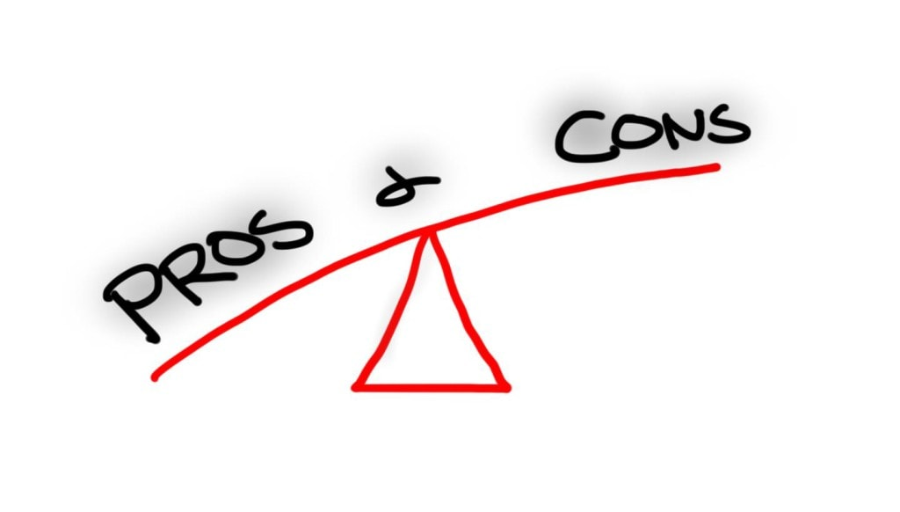
Virtual Teams Pros and Cons: All You Need to Know

Slide 29
Virtual Teams Pros and Cons (The PROS)
Happier Employees
This is one of the biggest benefits of a virtual team. When you’re working remotely as an employee, you have the flexibility to balance work/ life tasks that are otherwise harder to manage around.
You don’t need to take a day off of work for a dentist appointment or a child’s teacher meeting; you just work around those personal tasks.

Slide 30
Virtual Teams Pros and Cons (The PROS)
More productive employees
Happier employees produce more, which means employers get more out of their employees.

Slide 31
Virtual Teams Pros and Cons (The PROS)
Cost Savings
Employers also save on real estate costs, which means more money in the bank.
They don’t have to worry about office space, travelling or leasing new facilities as their team grows. Even if a team is not entirely virtual, having a partial remote
This makes an organization more competitive because it can use those savings for more strategic initiatives.

Slide 32
Virtual Teams Pros and Cons (The PROS)
Bigger Talent Pool & Extended Hour Coverage
When a company builds a virtual workforce, the talent pool opens up to candidates all around the world.
Employers are no longer restricted to hiring in their own geographic region, and don’t have to worry about relocating people. This gives them access to a much bigger skillset at a fraction of the cost.
An added bonus is that they get to strategically hire resources in other countries to have extended time coverage on business hours (including a 24-hour cycle for functions such as customer service.)

Slide 33
Virtual Teams Pros and Cons (The PROS)
Lower Carbon Footprint
Employers also use less office space, which means lower usage of heating, cooling, water, and electricity utilities as well. All of that reduces the carbon footprint and contributes positively to the environment.

Slide 34
Virtual teams Pros and Cons (The CONS)
The Trust Factor
A top issue that managers have about virtual teams is whether they can trust that their employees do the job they’re supposed to do.
This is a valid concern.
If managers can’t see what their employees are doing, then how can they trust that their employees are not wasting time on personal tasks?

Slide 35
Virtual teams Pros and Cons (The CONS)
Reduced Team Collaboration
Another issue is the lack of team collaboration.
Virtual teams can be very transactional by nature where everyone is off doing their own job in their separate silo.
Some teams feel that the lack of face-to-face interaction in virtual environments adds to the problem of communicating or collaborating effectively. That’s because they miss out on reading subtle cues such as facial expressions and body language signs by their team members.

Slide 36
Virtual teams Pros and Cons (The CONS)
Social Isolation
Virtual teams can feel very lonely, which leads to social isolation of team members.

Slide 37
Virtual Teams Pros and Cons (Conclusion)
However, I do understand that virtual teams are not for everyone, and that there are certain industries or situations where focusing on a non-virtual model could make more sense.

Slide 38
What is meant by human resource information system?
A human resource information system (HRIS) is software that provides a centralized repository of employee master data that the human resource management (HRM)
group needs for completing core human resource (core HR) processes. ... In some ways, an HRIS can be considered a smart database of employee information.

Slide 39
What are the key functions of a human resources information system?
HRIS solutions feature data entry, data tracking, data analysis, and information-related capabilities to address a wide range of human resources department needs, including applicant tracking, onboarding, payroll, performance management and accounting functions.

Slide 40
What is the role of information technology in human resource management?
By focusing on using technology to continuously improve the quality of the work. Technology can improve the information available to HR, facilitating HR processes, and making them faster and more effective. One of the biggest allies in HRM, HRIS is adopted to make organizations more accurate and effective.

Slide 41
What are HRIS applications?
HRIS (human resources information system) is a type of business application that enables companies to store employee information, manage common HR functions,
and execute critical HR activities such as processing payroll and administering benefits

Slide 42
What is an example of HRIS?
Examples of HRIS systems include: Applicant tracking systems (ATS) to help the hiring process. HCM (human capital management) ...
Payroll management tools for compensation management.

