Slide 1
Workshop on Strengthening Financial Management of Civil Society Organizations
August 25 – September 27, 2021
27 Lesson Hours in 17 Days – Fin Module
(Through Virtual Meeting – Zoom Technology)

Slide 2
Module 5: Procurement Procedure
About This Module
This module is designed, you to learn about its purpose, how to establish procedures for the business for procurement of all goods, works, services and consultancy services, and ensure that all aspect of procurements are obtained in cost-effective prices, at the required specifications and quality and are delivered in time etc…
The policy framework and the templates references discussed through this module can help you to set up, revise or realign overall procurement activities that ensures maximizing economy and efficiency while adhering to prescribed standards, specifications, rules and regulations established by the top management in replacement with an entity specific procurement guidelines.

Slide 3
Module 5: Procurement Procedure
Lesson 13 & 14 : Overview and the framework of standard procurement process for CSOs & Procurement preparatory activities and procurement planning - September 21
Lesson 15 & 16: Commonly used procurement methods and financial delegation under direct procurement & Preparation of biding documents and bidding procedure - September 22
Lesson 17 & 18: Contract administration practices & Stores and (inventory) management - September 23
Lesson 19: Selection and recruitment of individual consultants and firms - September 24

Slide 4
Overview and the Framework of Standard Procurement Process for CSOs
What is basic procurement?
Procurement is the process of finding and agreeing to terms, and acquiring goods, services, or works from an external source, often via a tendering or competitive bidding process.

Slide 5
Procurement Process: The Stages in the Procurement Process
What is procurement?
Procurement is the process of finding and acquiring all of the goods, services, works and consultancy an organization needs to operate and fulfill its business model.
Procurement’s end goal is to reduce overall costs by finding the best possible prices and ensure that companies get what they need in a timely manner.

Slide 6
Procurement Process: The Stages in the Procurement Process…
What is the procurement process?
The procurement process is the name for all of the steps an organization must take to acquire the products and services it needs to do business.
Typically a procurement process will start from the minute a purchase request is placed, and involve steps like identifying suppliers, negotiating price, invoice approval, right through to receiving the goods.

Slide 7
Procurement Process: The Stages in the Procurement Process…
It’s important to note that there’s no “one size fits all” format for the procurement process flow. The steps in a company’s procurement process will depend on several factors like:
Business model
Company size
Location of business
Company structure
How to handle budget and spending
Human resources (e.g. does the company have a procurement manager or not?)
Some organizations like government institutions are often subject to restrictions in law and strict industry-specific guidelines which can also affect the steps involved in the procurement process. For example, ICTAD guidelines - standard bidding documents for works constructions

Slide 8
Procurement Process: The Stages in the Procurement Process…
The steps in the procurement process
Although every organization’s procurement process is slightly different, there are several key steps that may be used as building blocks to create and refine a CSO’s procurement process and the key steps.
Step 1: identify what’s needed
First stage in the procurement process is recognizing the need for a product (a brand new item, or something the company is re-ordering or pacing a repeat order) or a service.
Business owners, executives, department heads, employees, and procurement managers can all handle this step.

Slide 9
Procurement Process: The Stages in the Procurement Process…
The steps in the procurement process
Step 2: submit a purchase request
The individual needing the purchase submits a purchase request to the company, usually via a written request or e – procurement software. Purchase requests are typically reviewed by the procurement team or a financial controller. If the request is approved, it will be turned into a purchase order. If the request is denied, it gets returned to the employee along with the reason why the request was rejected.

Slide 10
Procurement Process: The Stages in the Procurement Process…
The steps in the procurement process
Step 3: assess and select vendors
Every business needs to determine where to get their goods. Some companies have an approved vendor cataloged, which is a list of suppliers that have successfully made it through the purchaser’s selection criteria and contract negotiations, while other companies are still trying to determine who the best suppliers are.
Once a supplier is chosen, companies should develop that relationship over time to establish the best value, get the best price, and save time on their future procurement activities.

Slide 11
Procurement Process: The Stages in the Procurement Process…
The steps in the procurement process
Step 4: negotiate price and terms
After choosing a supplier, the procurement team will negotiate the best price and specific terms (e.g. delivery times) for the purchase.
Step 5: create a purchase order
A purchase order is a formal contract used to buy the product. The purchase order outlines the price, specifications and terms and conditions of the product or service and any other additional obligations.
When you’ve signed the contract, forward the purchase order to the vendor. A legally binding contract activates right after a vendor accepts and acknowledges a purchase order.

Slide 12
Procurement Process: The Stages in the Procurement Process…
The steps in the procurement process
Step 6: receive and inspect the delivered goods
Once delivered, the receiving company is responsible for inspecting the product and accepting receipt. The company can reject the receipt of the delivery if the product is not up to standard (e.g. damaged or missing product). Rejection is almost always due to a damaged product.

Slide 13
Procurement Process: The Stages in the Procurement Process…
The steps in the procurement process
Step 7: conduct 3-way matching
At this stage of the procurement process, the procurement team will use 3 - way matching to reconcile three key documents and ensure that the transaction is accurate:
Purchase orders
Packaging slips (these will arrive with the order)
Vendor invoices
Three-way matching can identify and prevent discrepancies that result in huge losses of income, so if a discrepancy is found it should be investigated and resolved immediately.

Slide 14
Procurement Process: The Stages in the Procurement Process…
The steps in the procurement process
Step 8: approve the invoice and arrange payment
Approve the invoice when everything looks good and a 3-way match is complete. Next, arrange payment.
Step 9: record keeping
The receiving (buying) company must maintain proper records for bookkeeping and accounting purposes. This means saving all relevant documents for every completed purchase. If you skip this step, you could find hot water during an audit.

Slide 15
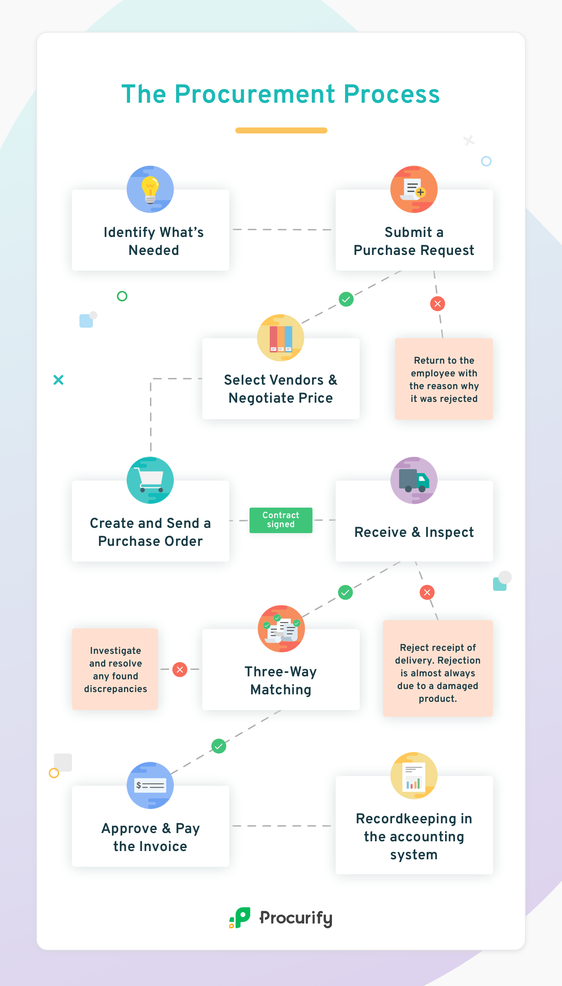
Procurement process flow chart
Sometimes it helps to see the procurement process as a flow chart, especially if you’re a visual learner.

Slide 16
Procurement Process: The Stages in the Procurement Process…
How to improve the procurement process
Organizing your organization’s purchasing process and introducing better procurement practices can have a huge impact on your company’s efficiency, output, and bottom line.
If you’re running a paper-based procurement system, switching over to procurement and purchasing software can be a transition at first, but the return on investment for your organization makes it a total advantage

Slide 17
Procurement Process: The Stages in the Procurement Process…
How to improve the procurement process
Use e-procurement software
An e- procurement solution software can improve how your company handles purchasing and the procurement process.
Streamline your purchasing and procurement processes
Maintain a centralized catalogue of preferred and approved vendors (which includes a list of the items or services each vendor offers)
Raise, send, and track purchase orders electronically
Perform 3-way matching (e-procurement stores purchase orders and invoices in the same place)

Slide 18
Procurement Process: The Stages in the Procurement Process…
How to improve the procurement process…
Avoid exceeding spending budgets
Introduce effective, transparent procurement and purchasing protocols
Eliminate annoying paperwork
Catalogue every transaction and maintain records
Electronically record every step in the procurement process (helpful during audits)
Manage suppliers effectively
Make it easier for employees to submit purchase requests with mobile and desktop app functionality

Slide 19
Procurement Process: The Stages in the Procurement Process…
Conduct periodic assessments
Conducting a periodical assessment of your procurement cycle and your suppliers can ensure your procurement process is fully optimized. Assessing things like supplier performance, supplier quality, and sourcing requirements will show you where there’s room for improvement and help you identify red flags before they turn into major problems.
The hidden benefit of these assessments is that checking in with suppliers, hearing their ideas for creating a win-win relationship, and listening to their needs can also help to strengthen your organization’s relationships with its vendors.

Slide 20
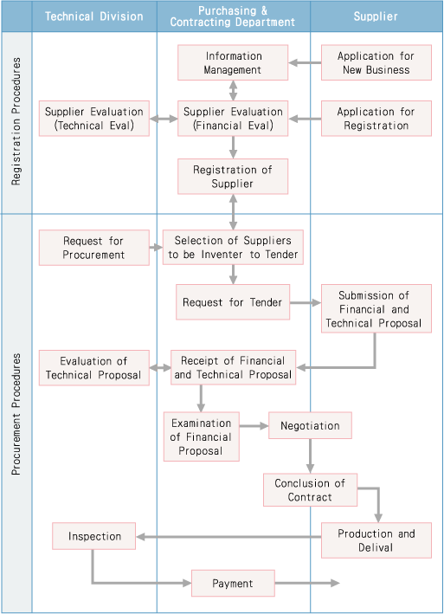
FLOW CHART OF STANDARD PROCUREMENT PROCEDURES

Slide 21
FLOW CHART OF STANDARD PROCUREMENT PROCEDURES
1. Selection of Suppliers to be invited to Tender
When procuring goods, works and services, CSO will select suitable suppliers of the item to be purchased from among registered suppliers. As a rule, tenders will be by competitive bidding between selected suppliers.
However, in certain cases, a specific supplier may be designated based on patent rights held by that supplier, compatibility with the existing facilities, whether they are the sole supplier of a given item, or similar situations.

Slide 22
FLOW CHART OF STANDARD PROCUREMENT PROCEDURES…
2. Request For and Submission of Tenders
A request for tenders indicating the conditions of the tender, contract conditions, and tender specifications will be provided to potential suppliers who will be invited to submit tender proposals.
Financial and technical proposals must be submitted by the specified date. In addition to the proposal made in accordance with the tender specification, alternative proposals containing additional cost-saving options other than as specified by CSO in the tender specification may be submitted provided that such alternatives meet the performance and function requirements as specified in the tender specification.

Slide 23
FLOW CHART OF STANDARD PROCUREMENT PROCEDURES…
3. Technical Evaluation
In principle, technical proposals will be evaluated prior to the opening of the financial proposal in order to confirm that the technical proposal conforms to the conditions and requirements set forth by CSO.
During the evaluation, CSO may request that the technical proposal be supplemented or amended. In cases where such changes could result in a change in the bid price, the supplier will be asked to submit such price adjustment and explanation.

Slide 24
FLOW CHART OF STANDARD PROCUREMENT PROCEDURES…
4. Negotiation and Award of Contract
We negotiate over the contract price and other conditions with the most advantageous tenderer to CSO among those tenderers which meet the specified technical condition and requirement.
We will show the tenderer our standard contract conditions and reach to an agreement after negotiation.

Slide 25
FLOW CHART OF STANDARD PROCUREMENT PROCEDURES…
5. Delivery, Inspections, and Payment
Products are to be delivered as agreed to in the contract. CSO reserves the right to claim liquidated damages if delivery is delayed beyond the specified delivery deadline.
CSO will inspect all products delivered by the supplier to ensure that they meet the requirements and conditions stipulated by CSO. Products which pass such inspections will be accepted. When necessary, inspections may also be carried out during the production process.

Slide 26
FLOW CHART OF STANDARD PROCUREMENT PROCEDURES…
5. Delivery, Inspections, and Payment…
In principle, payment will be made the month following acceptance of the product. However, other payment methods may be considered based on mutual discussions in cases where a long term period is required for production or where other special circumstances exist.
6. Other
Proprietary information obtained during the course of any transaction shall be subject to strict confidentiality on the part of both CSO and the supplier concerned. Such information shall not be disclosed to any third party unless otherwise specifically authorized in writing.

Slide 27
Procurement Procedure for CSO
The Purpose
The purpose of the Procurement Guideline is to set forth the procedures that should be adhered by the CSO, in carrying out any Procurement action financed in whole or in part by the CSO
Procurement Entity
Means CSOs that engages in procurement
Donor Funded Project
Means project financed by pursuant on any donor agreement, which finance the subject procurement actions.

Slide 28
Procurement Procedure for CSO…
Procurement
Means obtaining appropriately of goods, works, non-consultancy services, or consultancy with CSO’s funds or funds from any other source whether local or foreign. It would include purchase, rental, lease or hire purchase, including services incidental to the supply of said goods or the works and disposal of stores items.
Bid, Quotation or Proposal
Is a formal offer by a potential bidder or consultant indicating the price at which supply of goods or works, non-consultancy services or consultancy services will be made should the bid, quotation or proposal is accepted

Slide 29
Procurement Procedure for CSO…
Procurement Actions
Means any action in furtherance of performance of goods, works, non –consultancy services or consultancy services.
Goods
Means raw-material, products, equipment and other physical objects of every description whether in solid, liquid or gaseous form.
Non-Consultancy Services
Means services other than consultancy services. Eg. Janitorial services, security service, currier services

Slide 30
Procurement Procedure for CSO…
Works
Means all construction works associated with the construction, reconstruction, demolition, repair or renovation of a building, structure or associated works such as site preparation excavation, erection of a building, installation of equipment or materials, decoration and finishing.
Consulting Services
Means the services provided by consultant of an intellectual and advisory nature in wide range of activities such as policy advice, institutional reform, management study, engineering services, architectural services, construction supervision, financial services, social and environmental studies and identification, preparation, and implementation of projects

Slide 31
Procurement Procedure for CSO…
Objectives
The Procurement process should ensure:
a) Maximizing economy and efficiency in Procurement resulting in least cost together with the high quality;
VALUE FOR MONEY
The procurement processes should be carried out to achieve the most advantageous combination of cost, quality and sustainability over the life cycle of the project.
b) Adhering to prescribed standards, specifications, rules and regulations;
c) Maximizing income in the disposal of acquired assets or in granting of rights, concessions or exclusive benefits;

Slide 32
Procurement Procedure for CSO…
Objectives
The Procurement process should ensure…
d) Providing fair and equal opportunity for interested parties to participate in Procurement;
e) Expeditious execution of Works and delivery of Goods and Services;
f) Compliance with local laws and international obligations;
g) Ensuring transparency and uniformity in the evaluation and selection procedure;
h) Retaining confidentiality of information provided by bidders.

Slide 33
Procurement Procedure for CSO…
Scope of Application
This guidelines applicable to CSO Financed as well as Donor Funded Projects of the CSO. Hence, this guidelines would be applicable to all Procurements irrespective of the source of funding.
However, when a Donor Funded Projects, is mandated by its funding agency to use the procurement guidelines of such funding agency, such funding agency guidelines shall prevail over the CSO’s guidelines to the extent applicable.
In the event of a conflict between the CSO’s guidelines and that of the funding agency, the funding agency guidelines shall take precedence over CSO’s guidelines.

Slide 34
Procurement Procedure for CSO…
Ethics in Procurement
Confidentiality
In all Procurement Actions, parties associated, namely, suppliers, contractors and officials shall ensure that they maintain strict confidentiality throughout the process.
Corruption
The officials involved in Procurement Actions shall not abuse their powers. An official who abuses one’s position in Procurement Action to derive benefits

Slide 35
Procurement Procedure for CSO…
Ethics in Procurement…
Conflict of Interest
Officials shall declare that they remain without a conflict of interest throughout the process. Should such a compromising situation arise, the official shall declare his/her interest and disassociate himself/herself from the process.

Slide 36
Procurement Procedure for CSO…
Ethics in Procurement…
No gifts or inducement to be accepted
Officials shall refrain from receiving any personal gain from any Procurement Action. No gifts or inducement of any value shall be accepted. Suppliers/contractors are liable to be disqualified from the bidding process if found offering any gift of value which may have an effect of influencing a decision or impairing the objectivity of an official.
Officials shall refrain from receiving any personal gain from any Procurement Action.

Slide 37
Procurement Procedure for CSO…
General Principles of Procurement
The award of contracts is governed by the following general principles:
Non-discrimination and equality of treatment;
Transparency;
Confidentiality of Contractors
Fairness
Openness
Accountability

Slide 38
Procurement Procedure for CSO…
Non-Discrimination and Equality of Treatment
The principle of “non-discrimination” is a cornerstone of Public Procurement. This principle prohibits any discrimination meaning that all participants shall be treated in the same manner, unless the difference is objectively justified. Both direct and indirect discrimination is prohibited. Bank must remain non-biased and Impartial toward all participants.

Slide 39
Procurement Procedure for CSO…
Transparency
Transparency in the context of public procurement refers to the ability of all interested parties to know and understand the actual methods and processes by which contracts are awarded and managed.
Confidentiality of Contractors
All bids should be kept in a safe and secure environment to ensure that the confidentiality of bids is preserved. Confidential information may include technical or trade secrets. The principle of confidentiality obligates the Bank not to examine the content of bids, before the deadline for their submission has expired.

Slide 40
Procurement Procedure for CSO…
Fairness
System needs to operate in a manner that is perceived as offering an opportunity for participants to win contracts in accordance with an agreed set of rules that are not “prejudiced” against participants without a reasonable explanation.
Openness
Relates to fairness, but is more specific as to ability of wide range of participants to participate in a competition. An example of lack of openness might be restricting procurement to national or local firms.

Slide 41
Procurement Procedure for CSO…
Accountability
Assuming responsibility for actions taken and being held to account for those actions. It also entails an obligation to explain and justify the procurement actions taken to perform tasks.

Slide 42
Procurement Procedure for CSO…
Laws applicable for Procurement Actions
The laws applicable to Procurement Actions shall be the Laws of the Democratic Socialist Republic of Sri Lanka unless such Procurement Actions are consequence to agreement/s or treaties between the CSO and other Foreign Funding Agencies and which imposed International obligations, the specific requirements of the treaty or agreement shall prevail.

Slide 43
Procurement Procedure for CSO…
Amendments to the Procurement Guidelines
Any amendment to the procurement guidelines shall be made by issuing Supplement/s approved by the Board of Director or Council of the CSO.
Council or Board of Director of the CSO
a) The BOD is the principle authority for formulating and effecting amendments to the procurement guidelines.

Slide 44
Procurement Committees and their Functions
Executive Director
a) The responsibility of Procurement Actions shall be vested with the ED of the CSO who is deemed to be the Accounting Officer. The responsibility and accountability of the other officers of the CSO who are involved in Procurement Actions shall be duly authorized by the ED in accordance with the Delegation of Financial Authority for each Financial Year.

Slide 45
Procurement Committees and their Functions…
Responsibility of the CSO
a) The CSO shall responsible for the entire Procurement Process i.e., Procurement Planning and Preparedness Activities, Pre-contract Activities and Post Contract Activities.
b) The respective Procurement Committees (PCs), Technical Evaluation Committees (TECs) and Bid Opening Committees (BOCs) shall be appointed by the BOD, ED or his delegated authority.
c) All PCs and TECs shall be appointed at the beginning of each financial year on ex-officio. The seniority and procurement capacity shall be taken into consideration when such appointments are made. However, members of TEC shall be changed depending on the expertise required.
d) Request shall be made by the ED to the BOD to appoint the PCs at the beginning of each financial year.

Slide 46
Procurement Committees and their Functions …
Responsibility of the Procurement Unit
Head of Admin Service Unit or Finance Manager of the CSO is responsible for the following activities:
a) Obtaining procurement requirements of all departments, divisions, regional office and project office before the end of current financial year for the ensuring financial year;
b) Prepare Master Procurement Plan (see Annex 1) and proposed Annual Procurement Plan (APP) (see Annex 2) by using the Format to incorporate such requirements by properly packaging and slicing;
c) Organize Procurement Planning Meeting before finalizing the APP;
d) Appoint TECs and BOCs within the provisions of the guidelines;

Slide 47
Procurement Committees and their Functions
Responsibility of the Procurement Unit …
Head of Admin Service Unit or Finance Manager of the CSO is responsible for the following activities…
e) Monitor and ensure that all the preparatory activities such as Specifications, Bill of Quantities (BOQ), Initial Environmental Examinations (IEE), Environmental Impact Assessments (EIA) Assessments, Plans, Drawings, preparation of draft bidding documents, obtaining necessary approvals etc. have been duly completed by the respective users for all procurement packages included in the APP and Procurement Preparatory Plans (see Annex 3) are duly submitted;
f) Assist and advice officers who need assistance and guidance to prepare such Preparatory Activities;
g) Assess the procurement capacity of officers of the CSO, particularly the members of different PCs and TECs and organize procurement capacity building activities from time to time;

Slide 48
Procurement Committees and their Functions…
Responsibility of the Procurement Unit …
Head of Admin Service Unit or Finance Manager of the CSO is responsible for the following activities…
h) Arrange the services from outside Procurement Specialists, Consultants etc. as per the provisions of this guidelines to prepare such preparatory activities whenever deemed necessary;
i) Maintain necessary communication with all internal and external stakeholders of the Procurement Process;
j) Arrange annual suppliers, contractors and service providers’ registration process;
k) Preparation of Invitation for Bids (IFB), Invitation for Pre-qualification, preparation and vetting of bidding documents, submission of such documents to respective TECs and PCs for review and approval;
l) Maintain a data base for all PCs and TECs and accredit members of PCs and TECs by considering timely completions of tasks, quality of evaluation reports, integrity of members;

Slide 49
Procurement Committees and their Functions…
Responsibility of the Procurement Unit …
Head of Admin Service Unit or Finance Manager of the CSO is responsible for the following activities…
m) Maintain a data base for all procurement activities carried out by the Bank and take prompt actions to complete the contract awards as scheduled using the Detailed Procurement Plan (DPP) (see Annex 4)
n) Obtaining Contract Administration Plans (CAP) (see Annex5) from respective Departments/Divisions/Regions/Branches and monitor implementation activities to ensure that all contracts awarded are completed as scheduled;

Slide 50
Procurement Committees and their Functions…
Responsibility of the Procurement Unit …
Head of Admin Service Unit or Finance Manager of the CSO is responsible for the following activities…
o) Assist to ED /BOD to appoint all PCs/TECs/BOCs, facilitate and coordinate all committees;
p) Provide information pertaining to contracts awarded by the CSO to BOD quarterly.
q) Provide progress reports on all procurement activities to the ED monthly.

Slide 51
Procurement Preparatory Activities and Procurement Planning-
Procurement Planning - Strategic Concern
a) Procurement planning is much more than a schedule of procurement requirements of the CSO. Importance of procurement activities of the CSO should be assessed considering many factors such as contribution to the total budget, achieving of corporate goals and objectives, ensuring value for money, assigning responsibilities to different officials and committees and supervision and monitoring of procurement activities of the CSO etc.;
b) The conventional approach is to request the procurement requirements from each departments/divisions or regions by the Procurement Division which is responsible to manage the procurement function of the CSO;

Slide 52
Procurement Preparatory Activities and Procurement Planning…
Procurement Planning - Strategic Concern
c) Once the requirement is received; some procurement is reduced or completely removed and finalized the procurement list. The inclusion or deletion has no rational basis what so ever. This is not meant of real procurement planning;
d) The procurement plan of the CSO should be prepared in line with the Action Plan. Since the Action Plan entails various activities, sub-activities and performance / output targets that are expected to be achieved under different goals and objectives of the CSO, procurements should be considered as the resource requirements to achieve such targets through such activities and sub-activities;
e) Since the activities and sub-activities are the best options available and determined by the management, the agreed resource allocation to such activities could be considered as strategic procurement planning.

Slide 53
Procurement Preparatory Activities and Procurement Planning…
Master Procurement Plan (MPP)
a) The CSO may prepare the MPP in line with its Action Plan. Where possible procurement activities envisaged - for a period of three-years - may be listed in the MPP;
b) The procurement activities for the succeeding year shall be prepared in detail;
c) The MPP shall assess the relative advantages of centralized versus decentralized Procurement; packaging of Procurement; size of the packages for Goods, Works, etc.;
d) The MPP shall be regularly updated, at intervals not exceeding six months;
e) Approval should be obtained for the MPP from the BOD.

Slide 54
Procurement Preparatory Activities and Procurement Planning…
Annual Procurement Plan (APP)
a) The CSO shall prepare an Annual Procurement Plan for the ensuring financial year before the end of the current financial year;
b) This plan spells out the procurement requirements of the CSO for the ensuring financial year;
c) This APP is essentially derived from the Annual Action Plan of the financial year;
d) This APP should entail all required details such as procurement packages /slices under different Procurement Categories i.e. Works, Goods, Non-consulting Services and Consulting Services (separate Plans), proposed Procurement Methods, Total Cost Estimate for each packages, the expected dates of Bid Invitation and Contract Award etc.;
e) Approval should be obtained for the APP from the BOD.

Slide 55
Procurement Preparatory Activities and Procurement Planning…
Procurement Packaging and Slicing
a) All procurement requirements should be packaged considering the suppliers point of view and required dates of procurement (see Annex 6);
b) In order for large and small suppliers/ contractors to participate for bidding, market capacity and to meet the critical delivery or completion schedules, large contracts may be divided into Smaller slices and procured on ‘slice and package’ method;
c) Both small and large contractors may be allowed, at their option, to bid for one or more slices or the whole package according to their capacity;
e) All bids shall be received by the same closing date, time and shall be opened and evaluated simultaneously so as to determine the Bid for combination of Bids that offers the lowest evaluated cost.

Slide 56
Procurement Preparatory Activities and Procurement Planning…
Procurement Preparatory and Planning
a) All the contract packages included in the APP, procurement preparatory activities should be identified by the user departments/ divisions such as preparation of specifications, estimates/ BOQs, drawings, plans, required approvals from local authorities, CEA and preparation of Bidding Documents
b) Procurement Preparatory Plan should also be submitted to the management along with the APP. It is the responsibility of the CSO to allocate funds required to complete the preparatory activities whenever applicable;
c) If preparatory activities are not planned properly and completed by the users, such procurements may not be included into the APP;
d) However, the Officer in charge of the subject of Procurement should monitor the preparatory activities

Slide 57
Procurement Preparatory Activities and Procurement Planning…
Detailed Procurement Plan (DPP)
a) Detailed Procurement Plan should be prepared once the APP is approved by the BOD in accordance with the format in the Procurement guidelines;
b) DPP is a schedule describing, steps of each individual Procurement action from the point of commencement until the contract award;
c) DPP entails Procurement Time Schedules (PTS) of each contract package included in the DPP;
d) PTS is a time schedule in chronological order;
e) PTS shall be prepared in two stages as described below;
f) The preparation and regular updates of

Slide 58
Procurement Preparatory Activities and Procurement Planning…
Detailed Procurement Plan (DPP)
Stage 1
Stage 1 of PTS shall include all activities after preparation of draft bidding documents. The responsibility of preparing of draft bidding documents rests with the CSO.
Stage 2
Stage 2 of PTS shall include all activities after preparation of bidding documents;
DPP shall entail all procurement requirements exceeding LKR 100,000
Responsibility of preparing the draft of Stage 2 is also rests with the Procurement Unit

Slide 59
Procurement Preparatory Activities and Procurement Planning…
Monitoring of Procurement Plan
All procurement activities spelt out in the DPP should be monitored by the respective authority. The head of Admin Service or Finance Manager will collect periodic information (at least quarterly) from all the HODs to ensure that all procurement activities are performed as scheduled. If the delays are apparent prompt actions to be taken by the head of procurement and report to the ED or BOD appropriately.
Average time frame for procurement process is given (see Annex 7)

